Slide 1

ERsed Respiration data- 2022
48 observations (sites) in total
Remove positive ERsed values (3 sites with ER_sed >0)
# Missing values: Hyporheic exchange flux (2), Chlorophyll_A(2),TSS(2),
Target variable in the MLR analysis: ERsed_square
Regression variables:
Depth, Velocity, Slope , Discharge
HOBO_Temp (water temperature)
Hyporheic exchange flux, Chlorophyll_A
totdasqkm (total drainage area),
D50_m, aridity, TSS, Stream order
PctMxFst2019Ws (%forest) , PctCrop2019Ws (%crop), PctShrb2019Ws(%Shrb)
GPP
Log transform for Slope, D50_m, totdasqkm, "Discharge", 'Average_Depth' and TSS

Slide 2
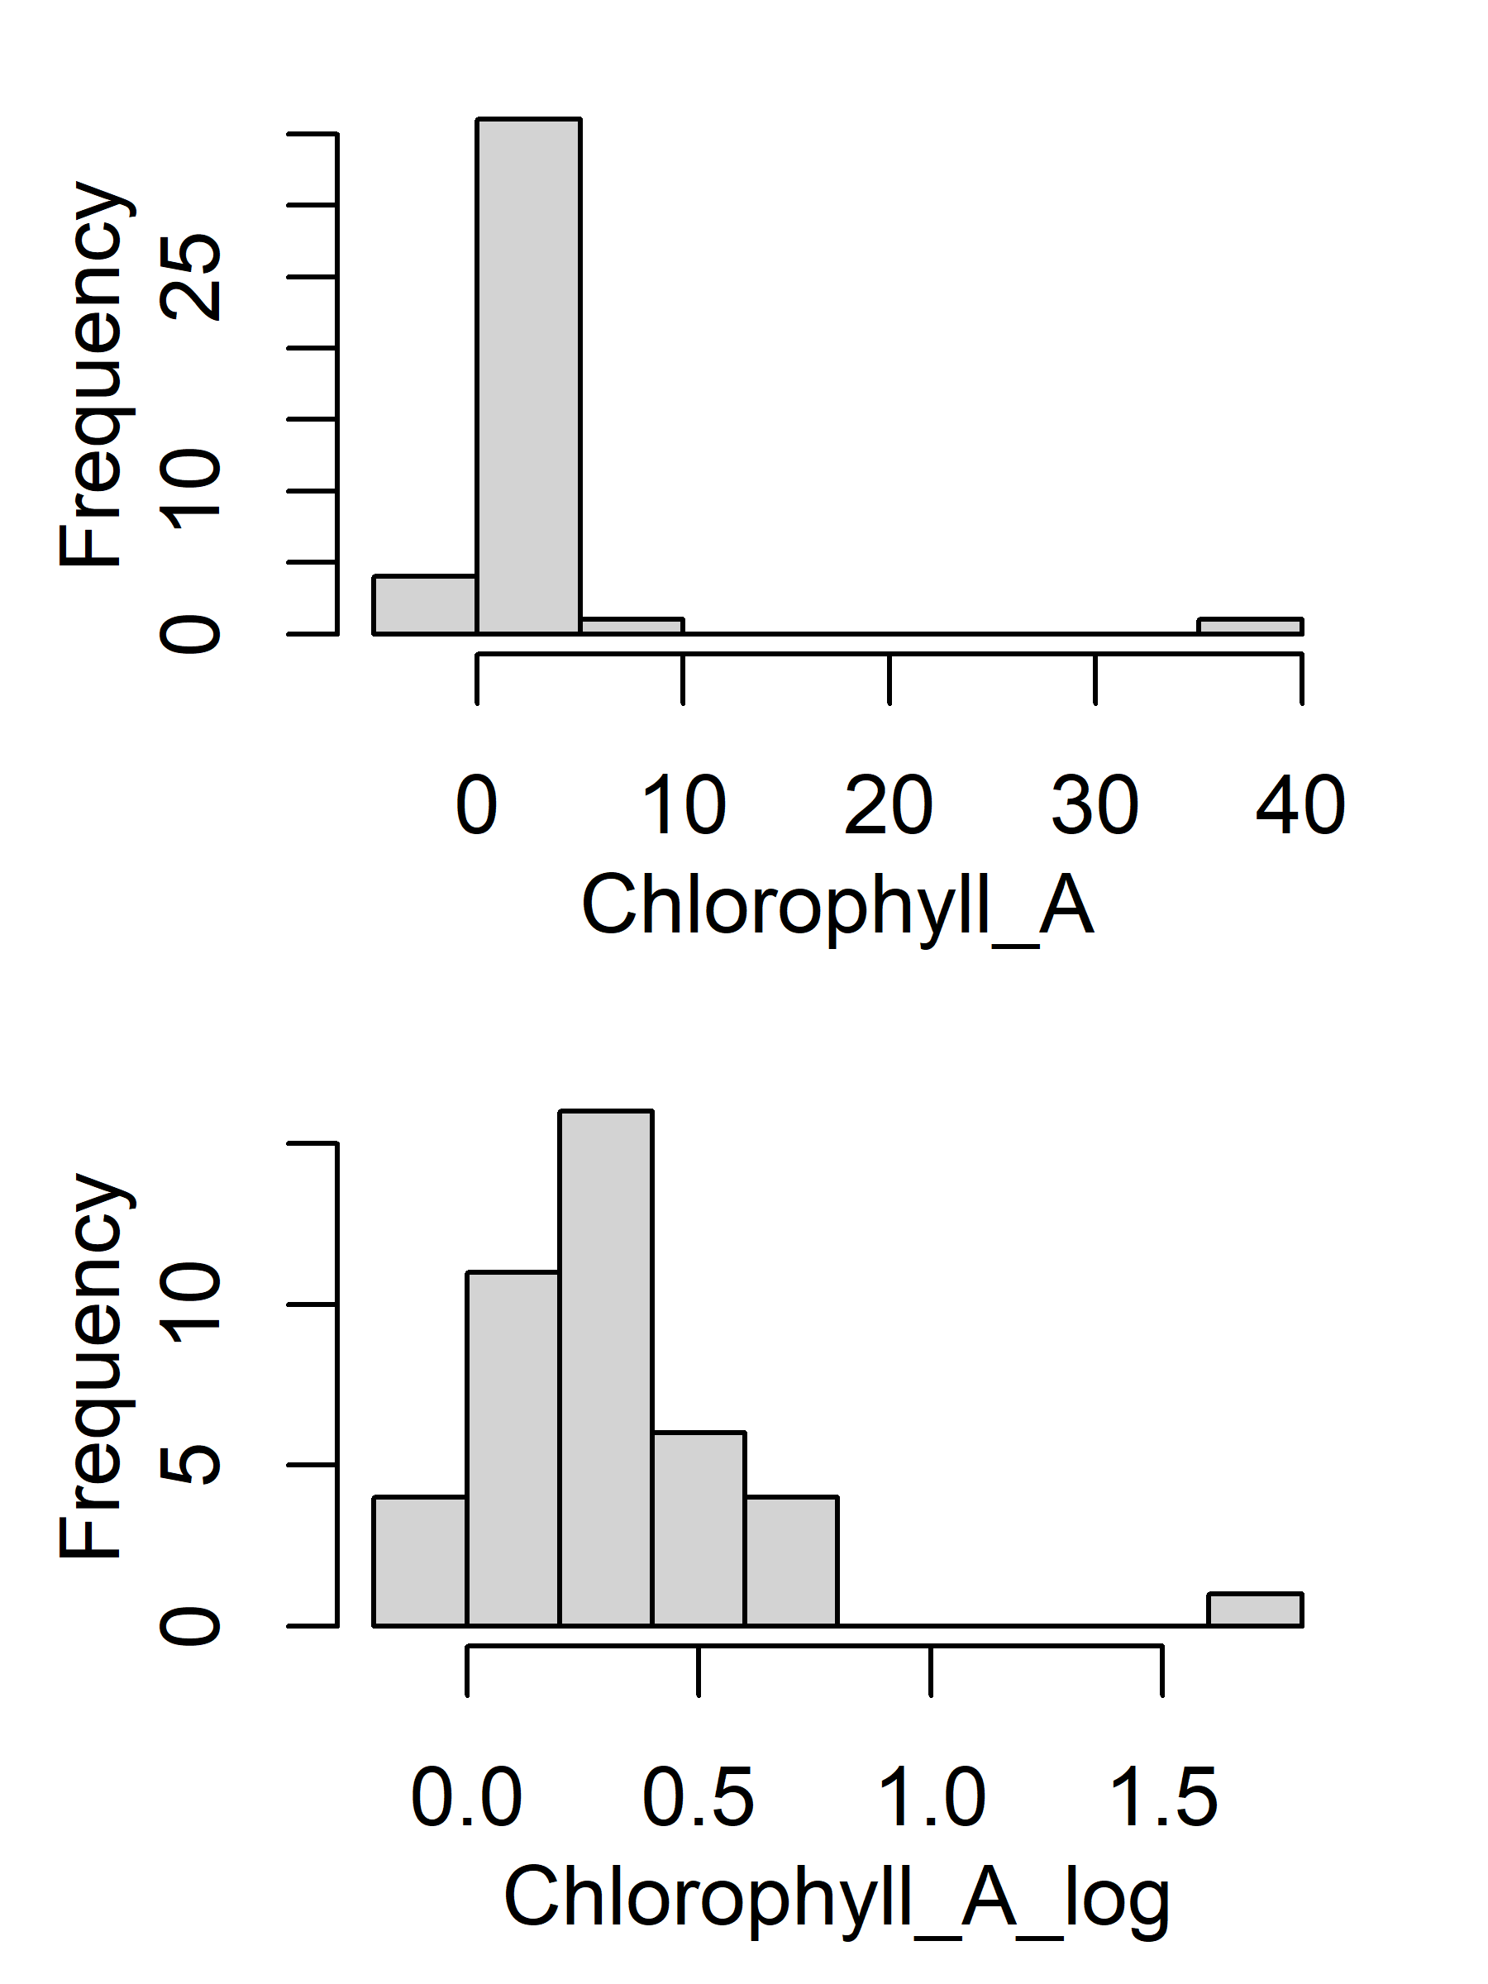
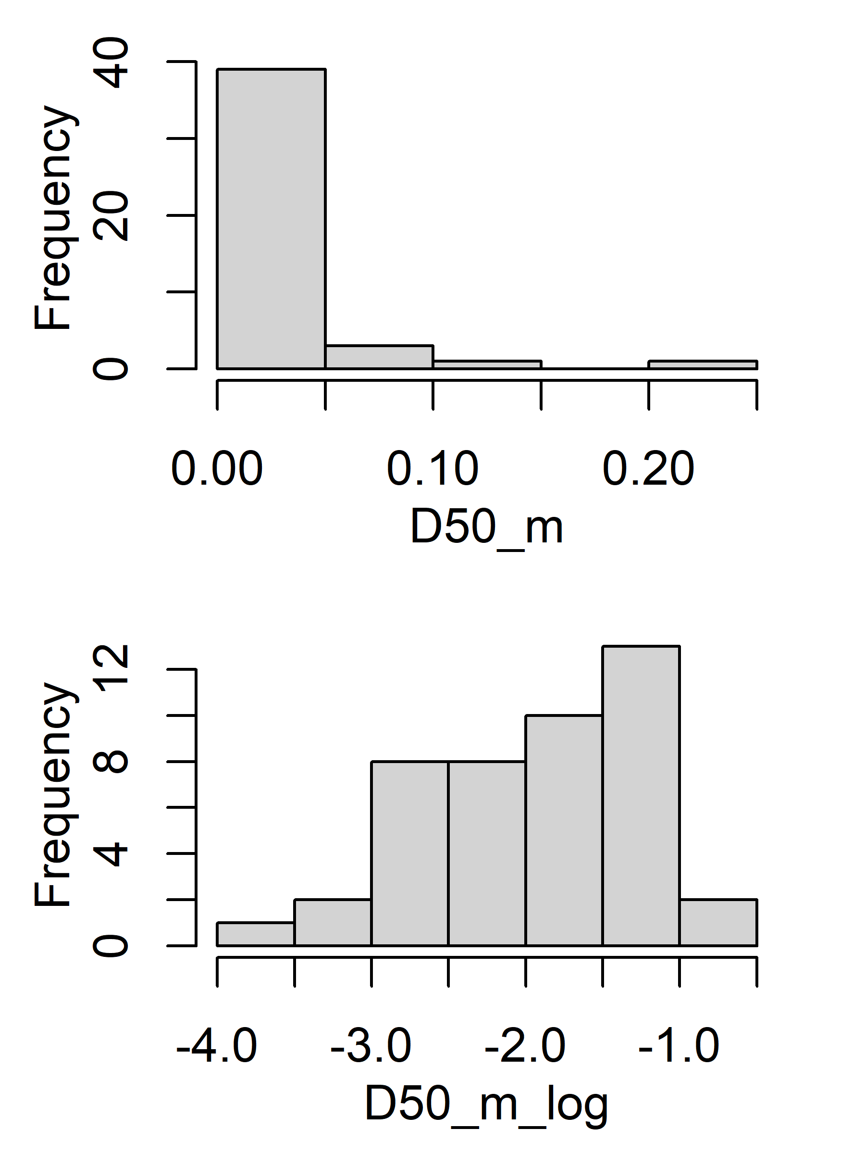
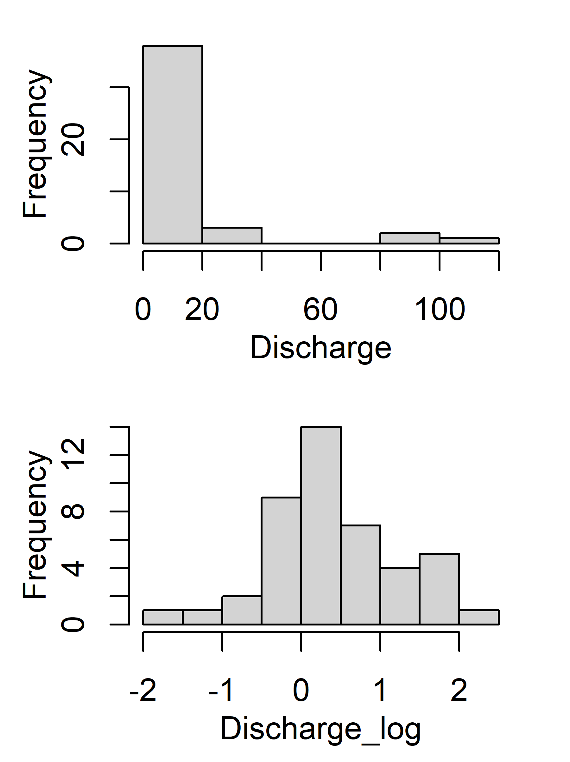
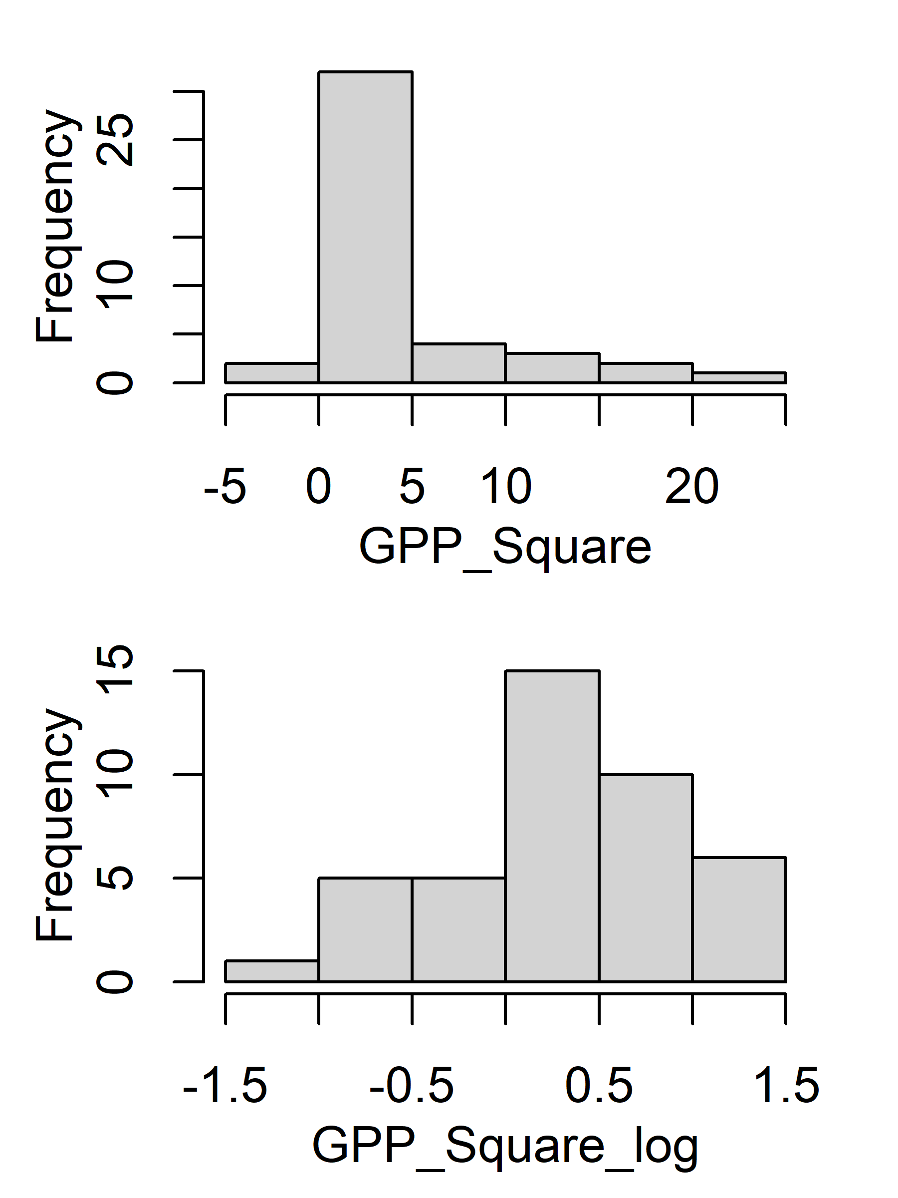
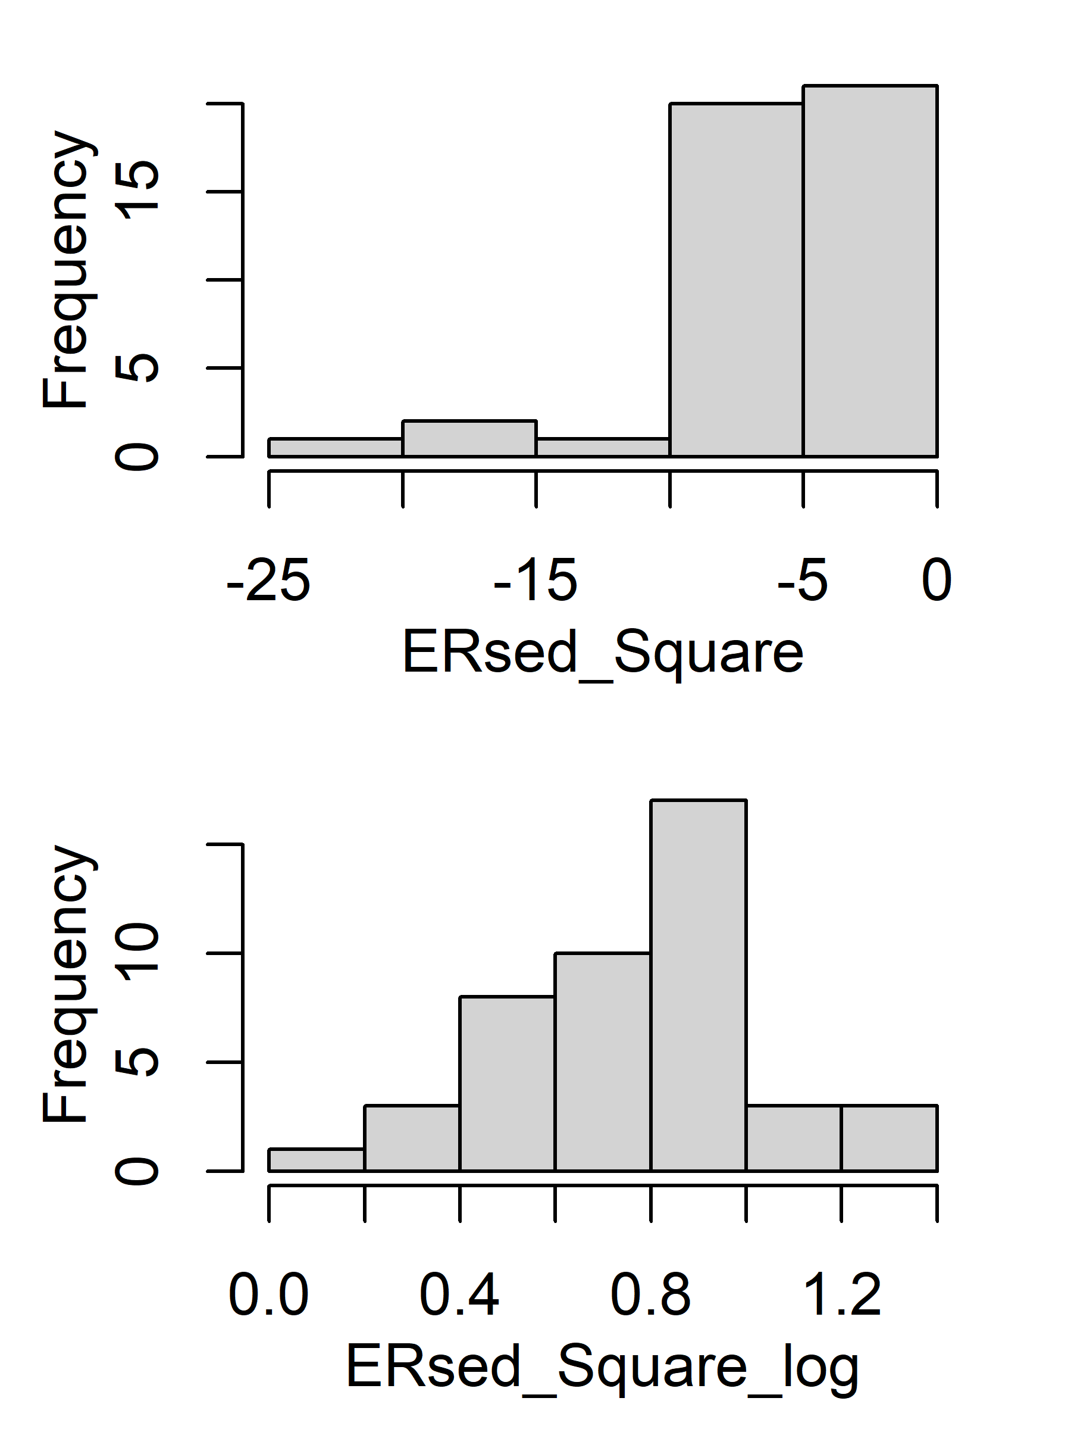
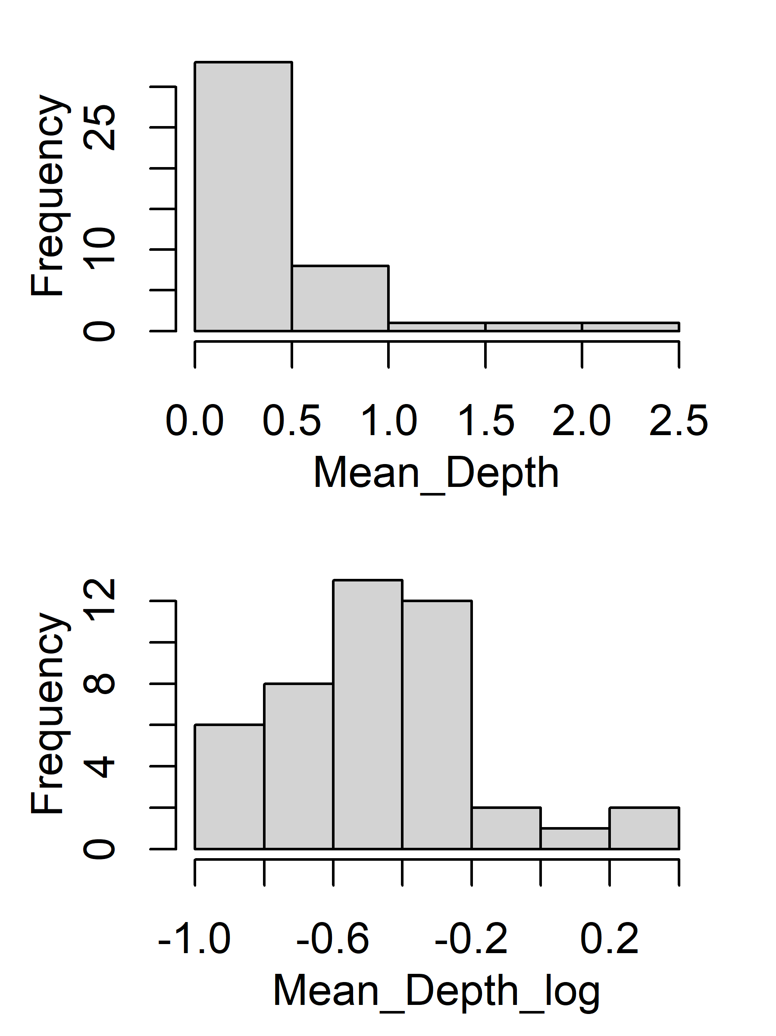
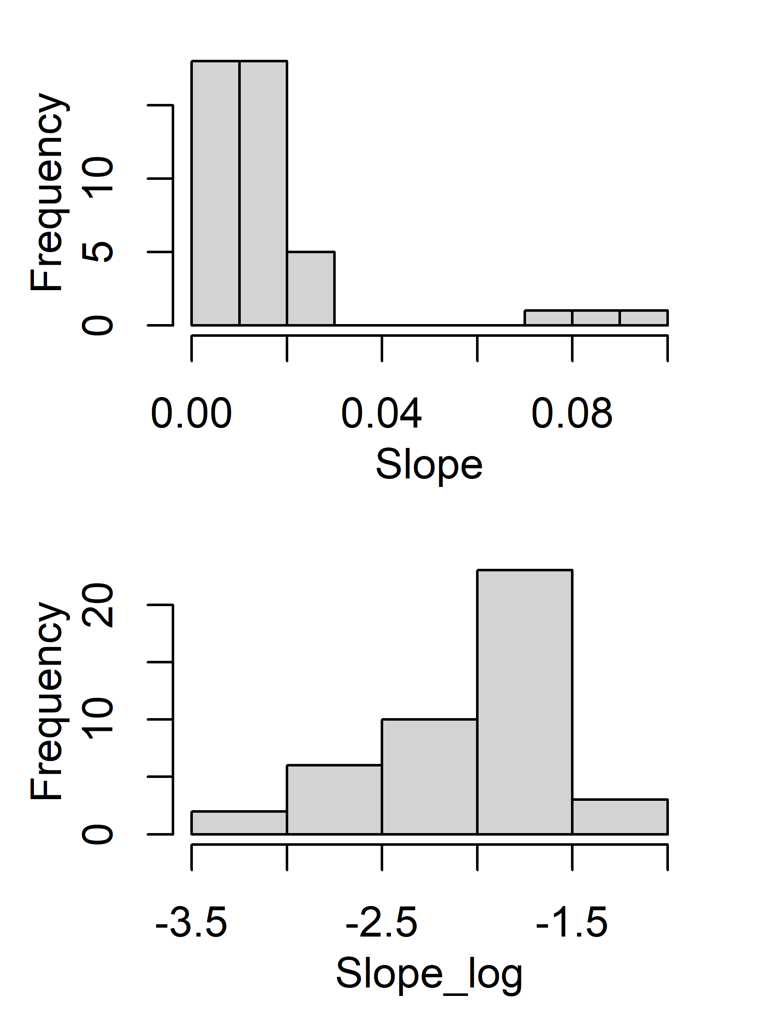
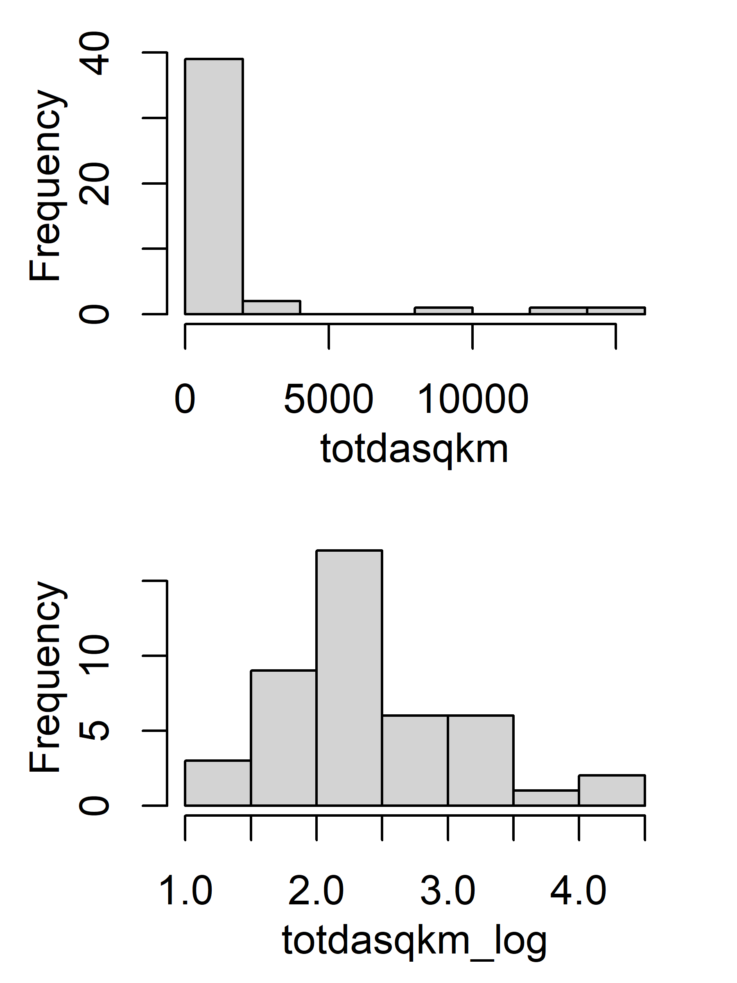
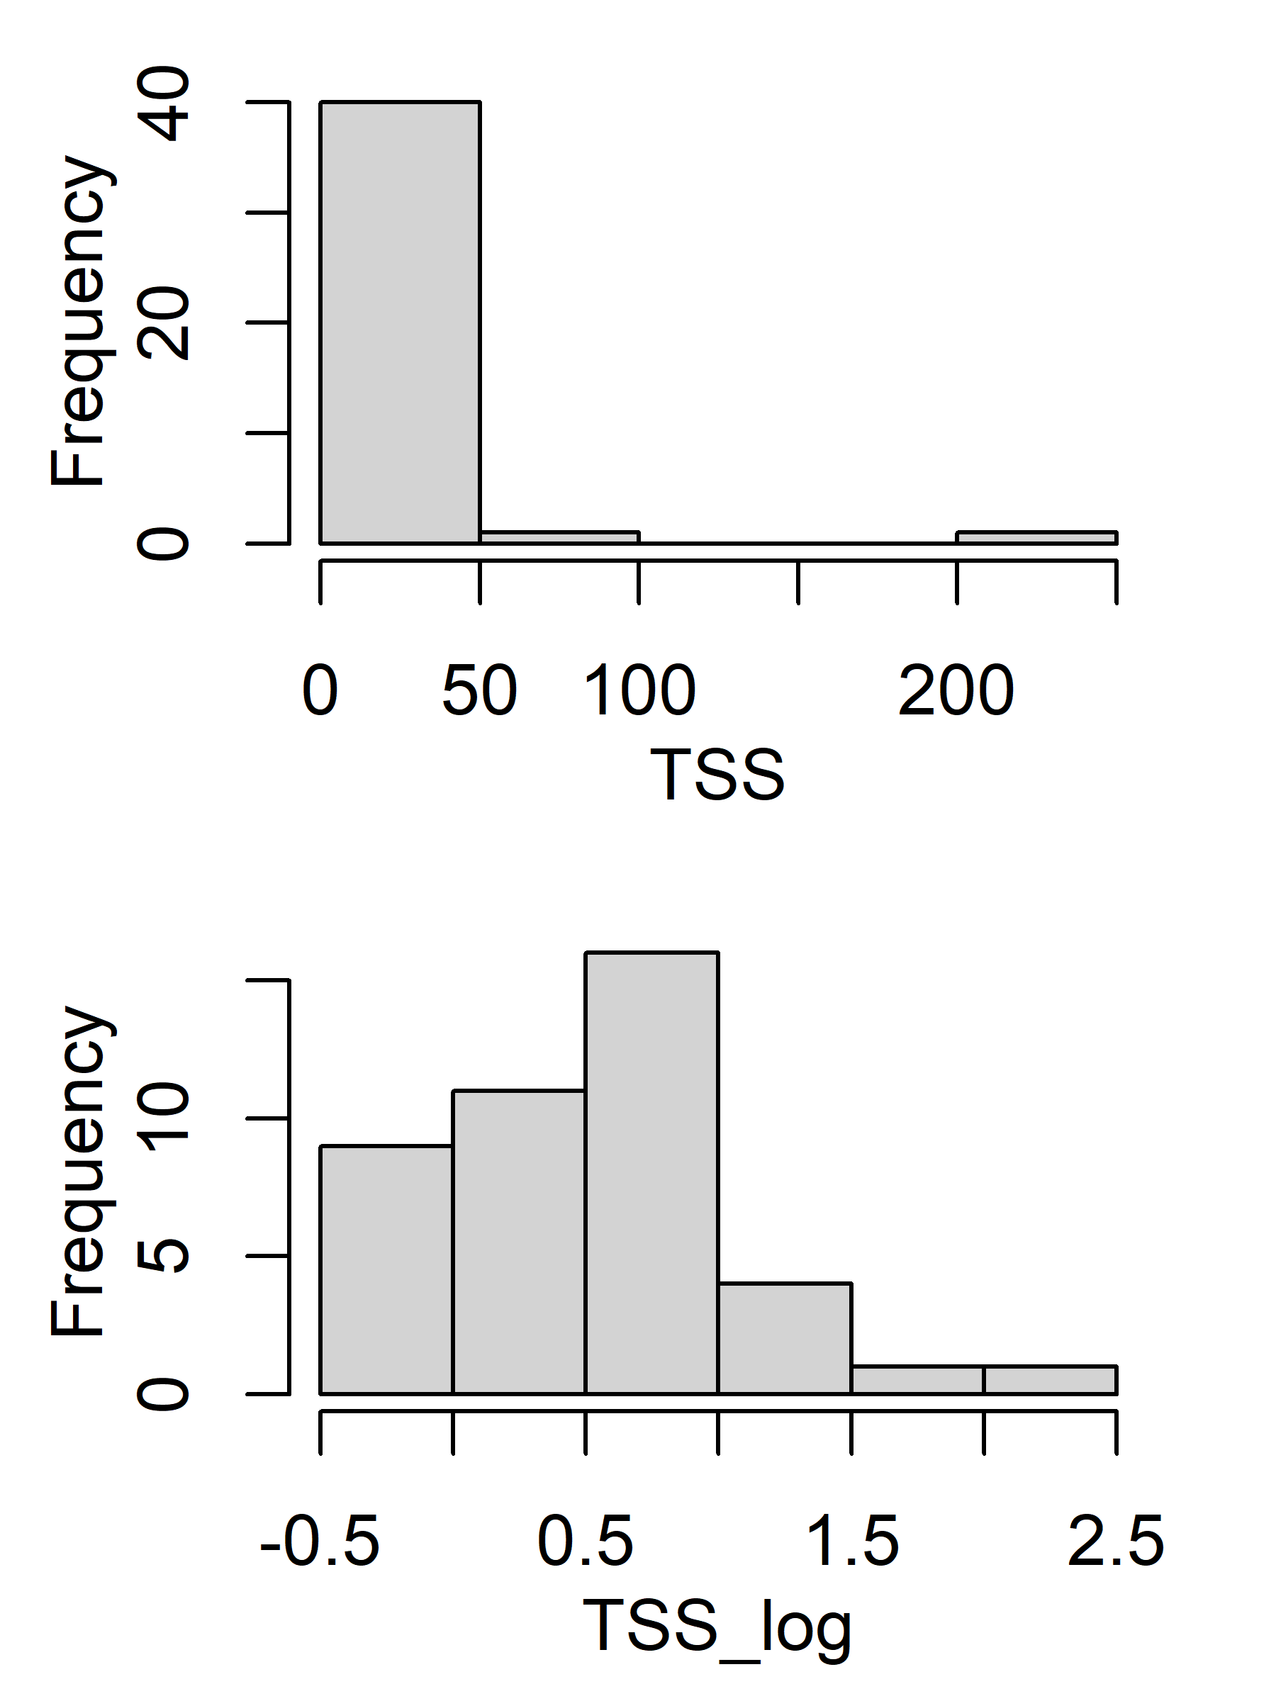
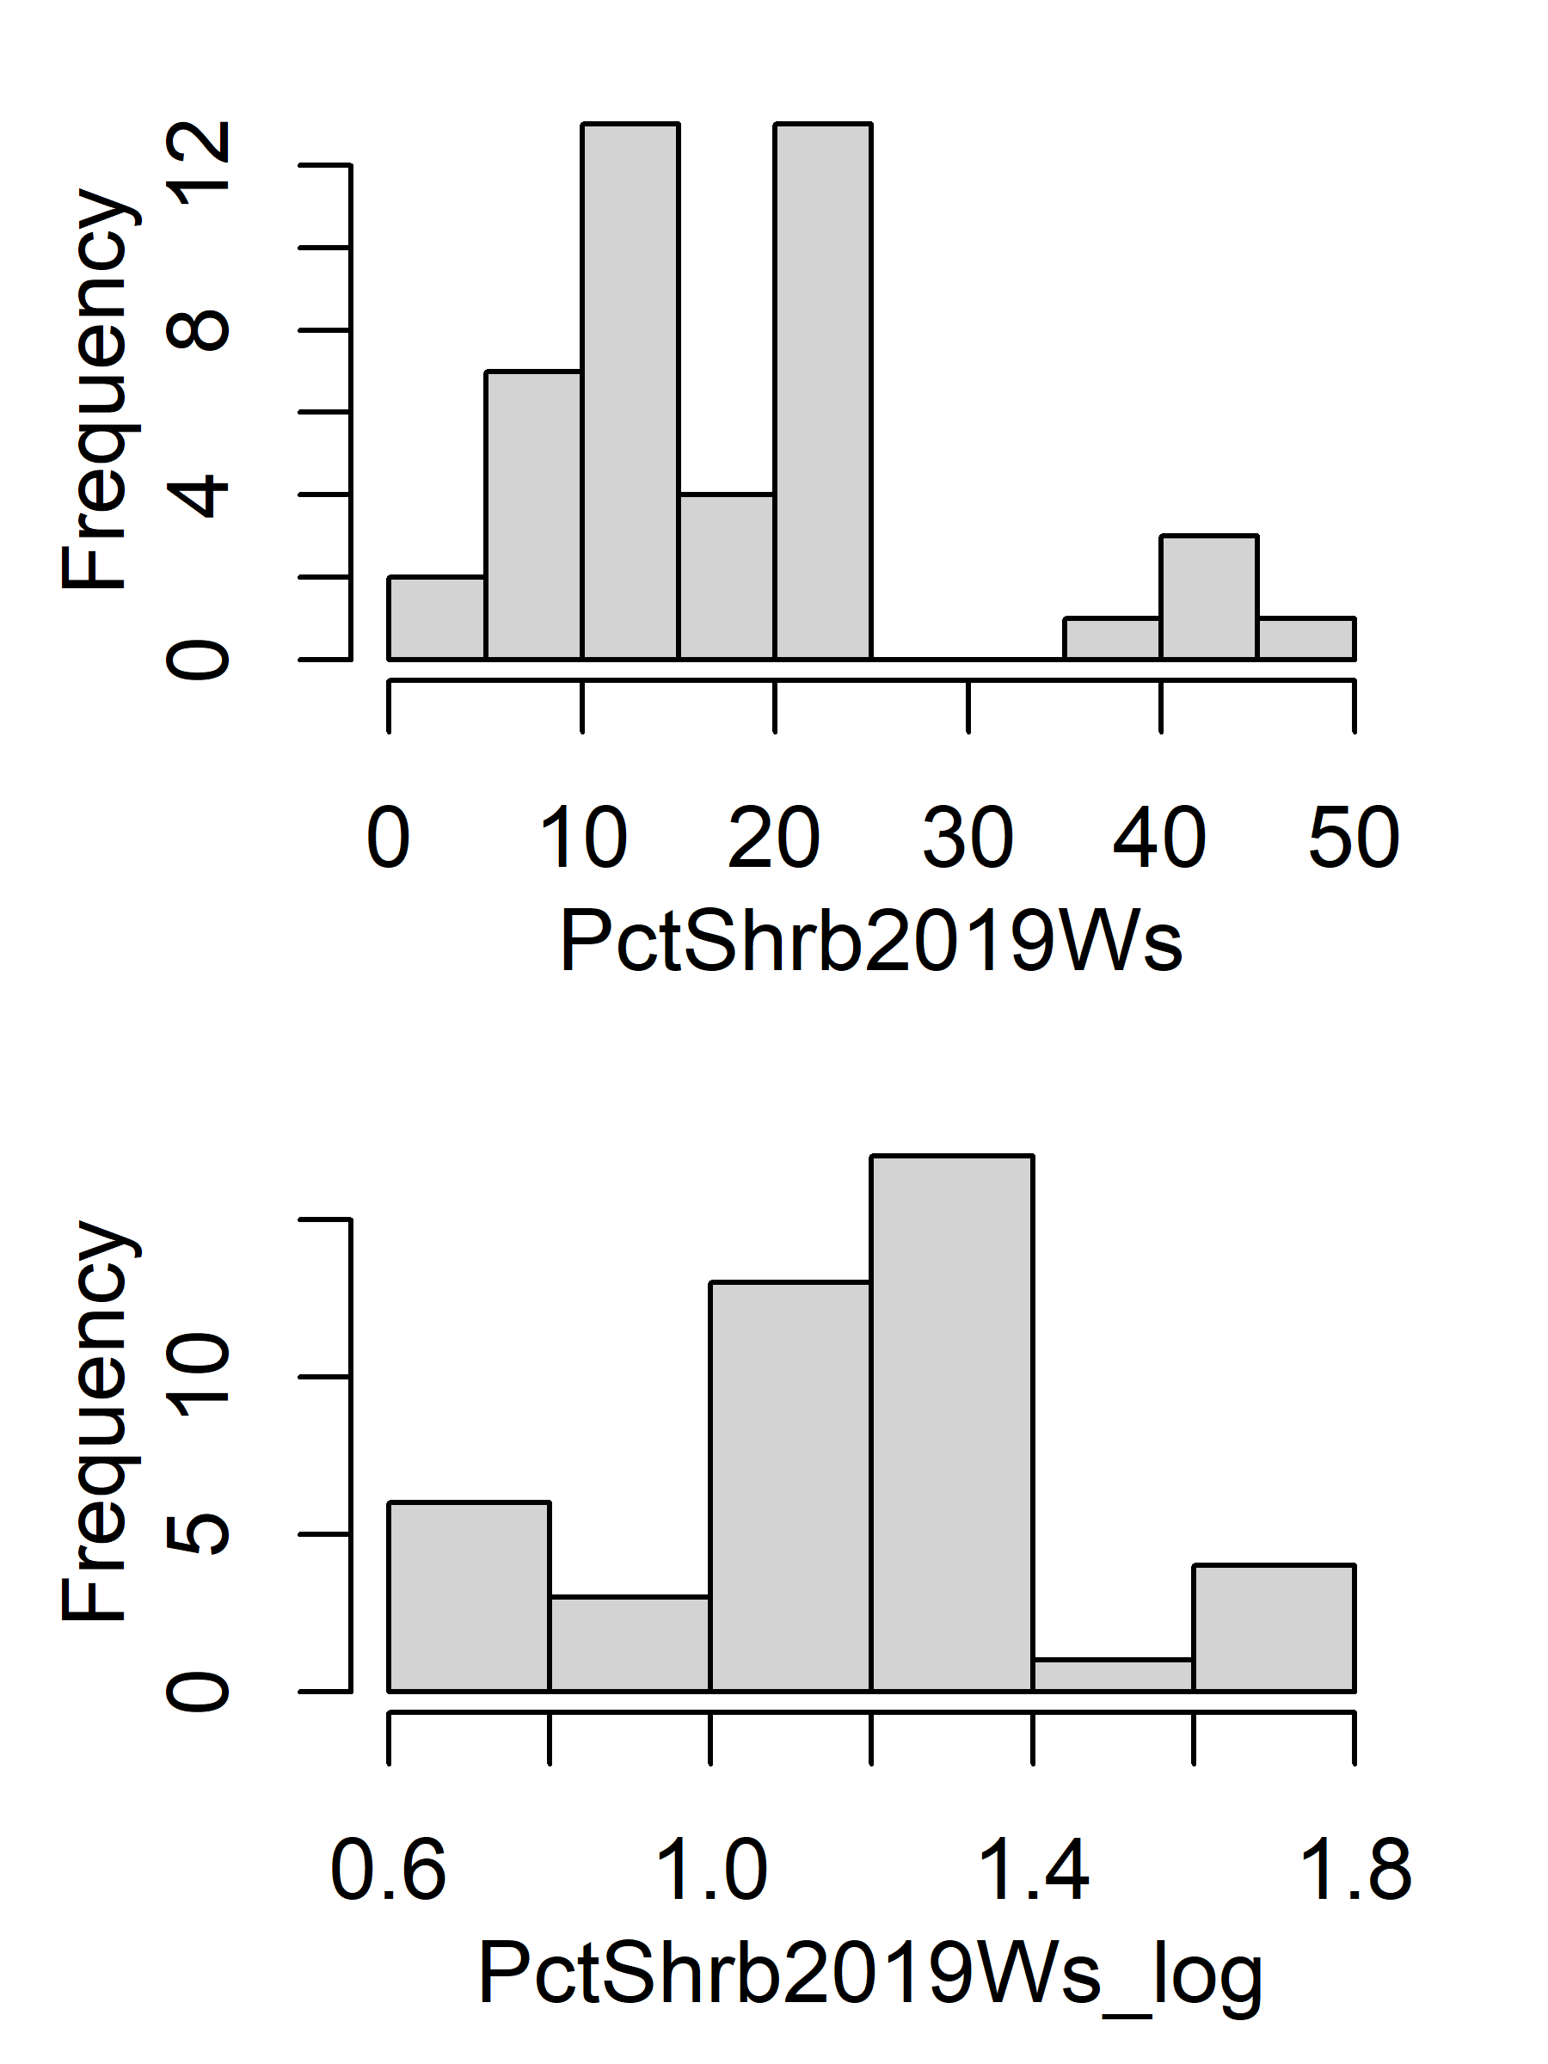
Histogram (original vs log)

Slide 3
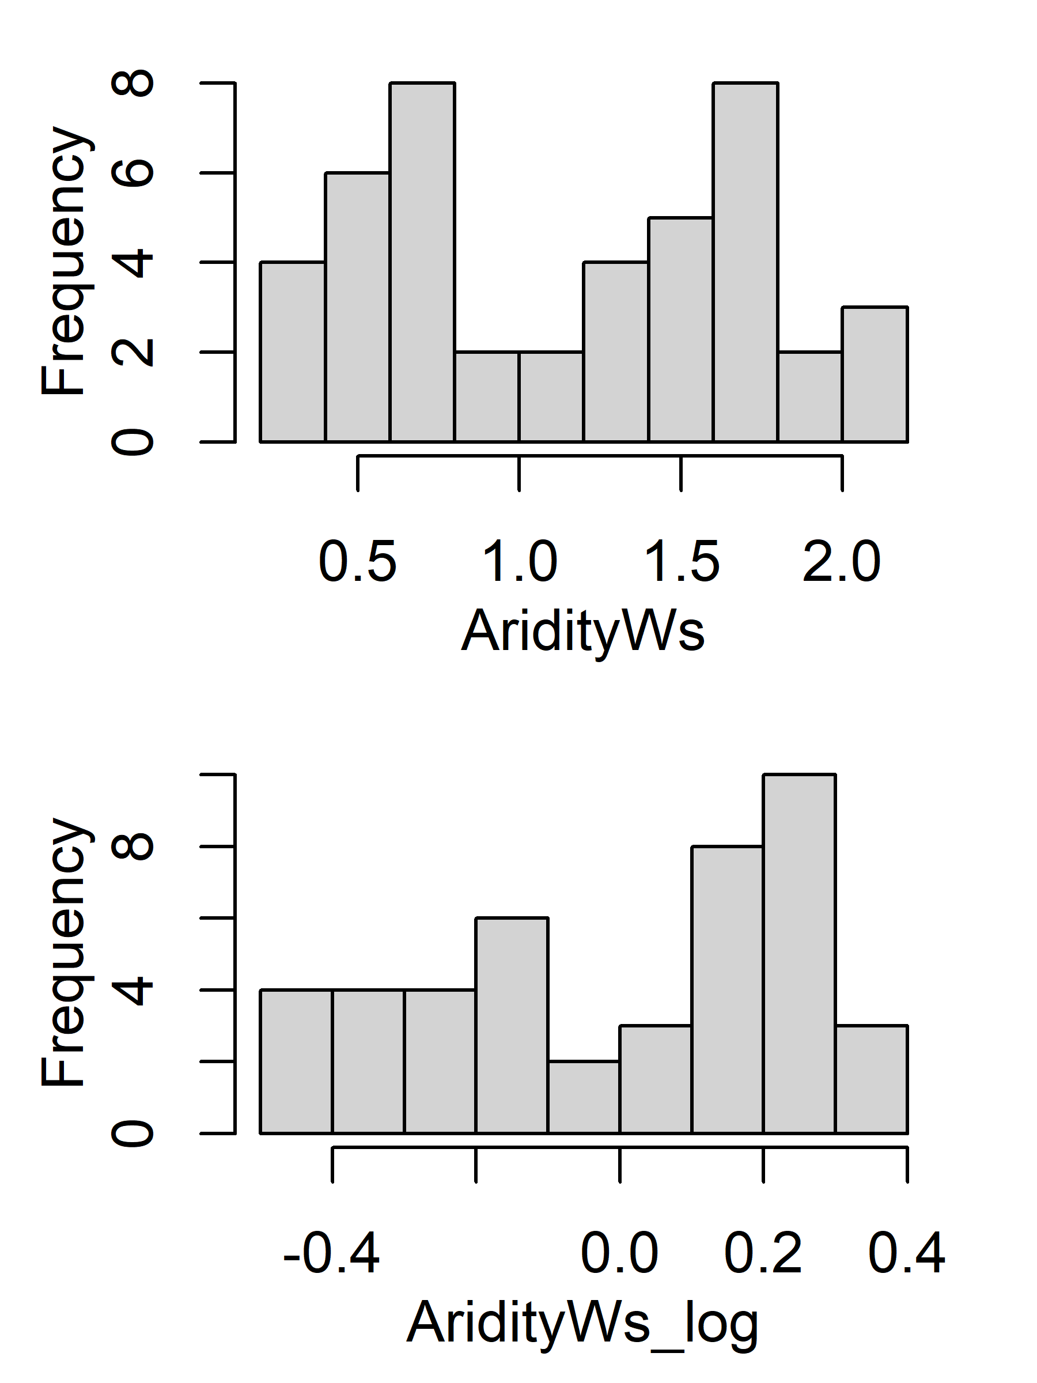
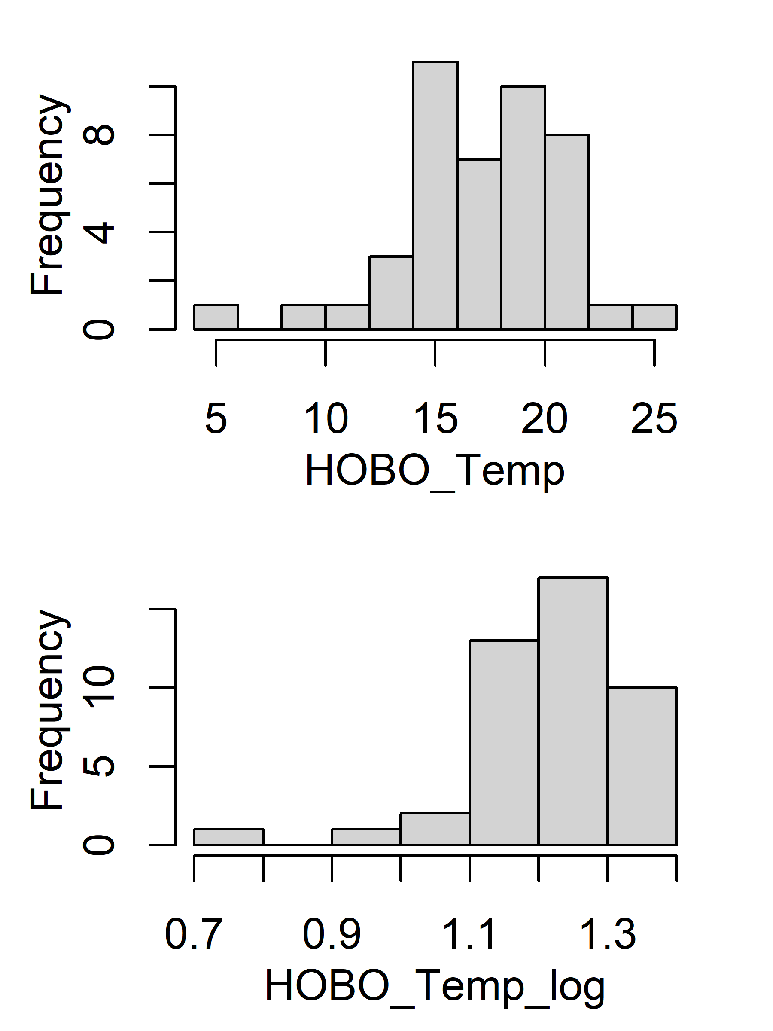
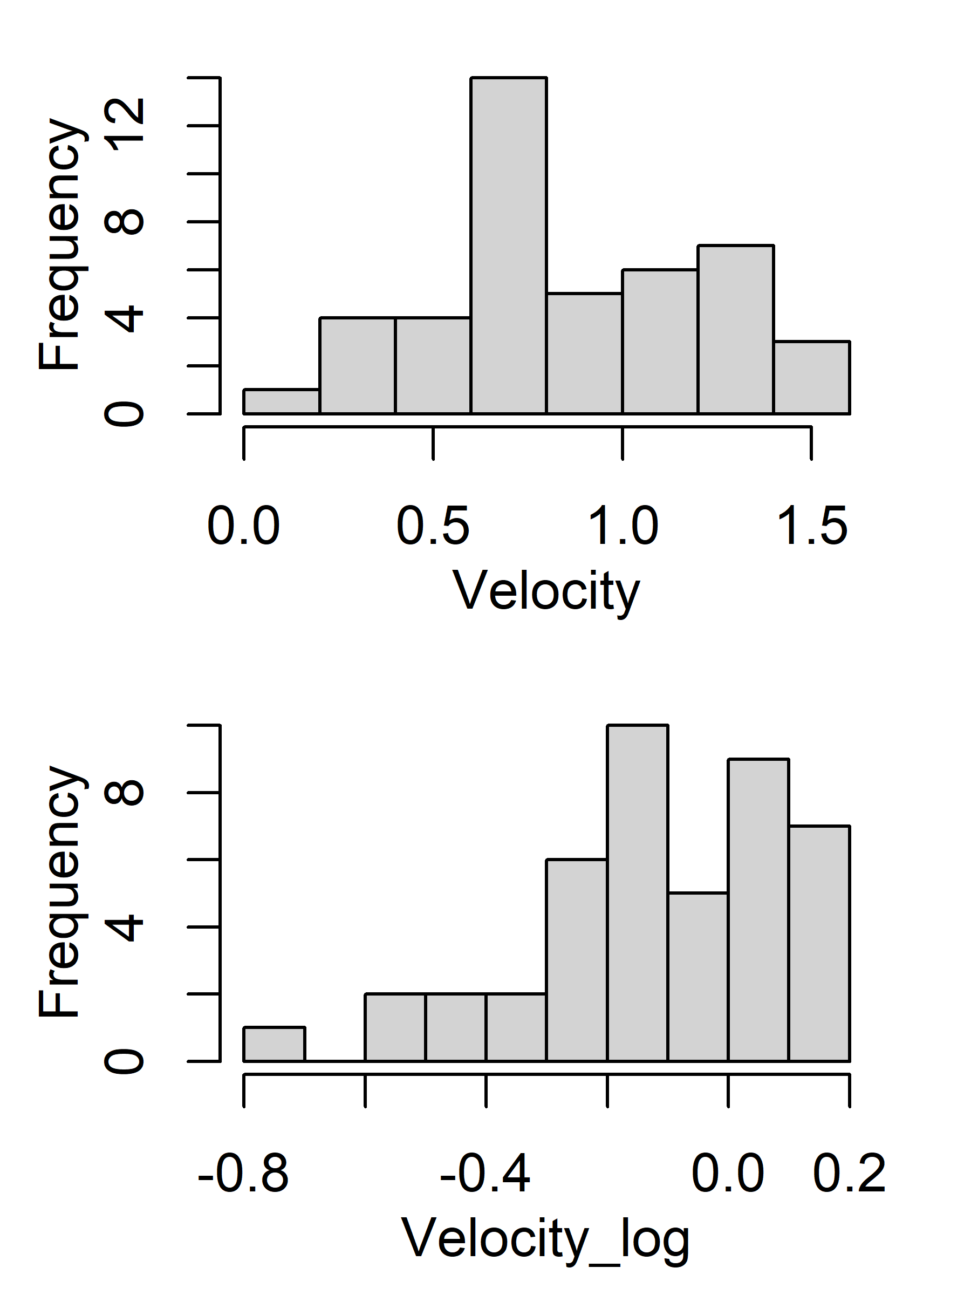
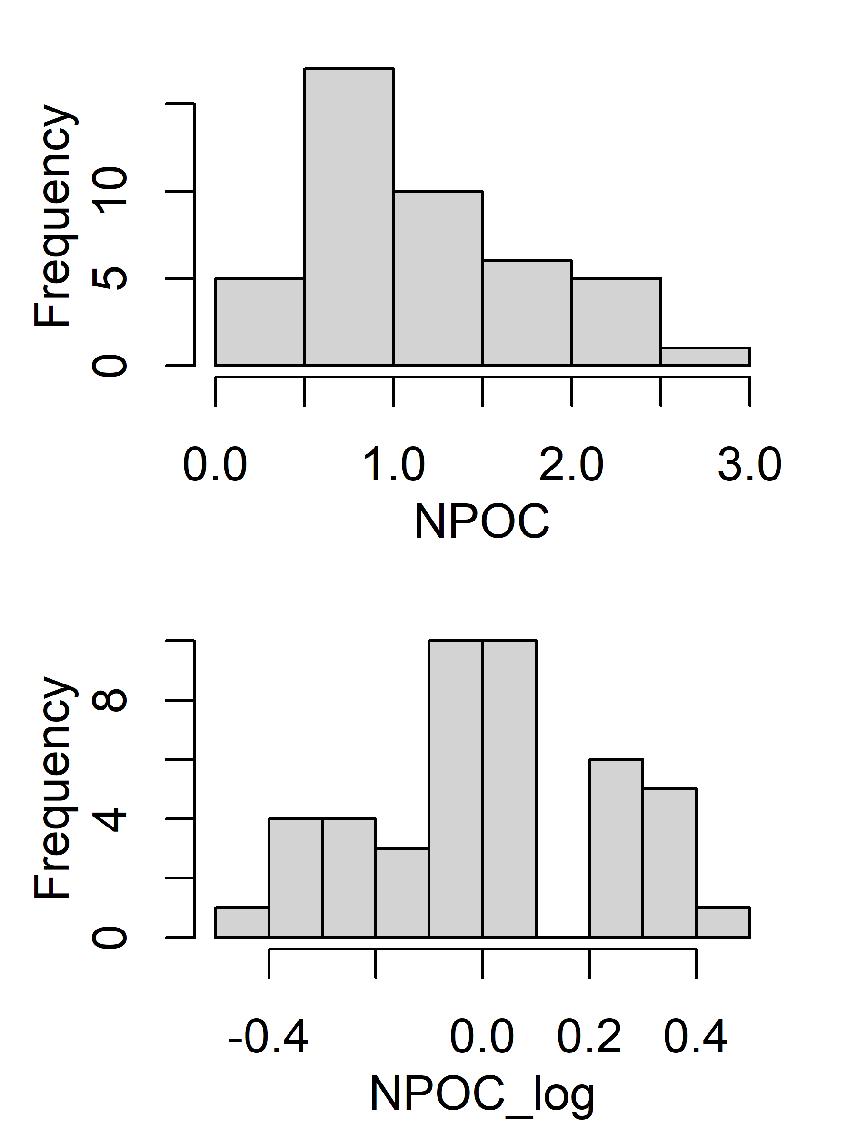
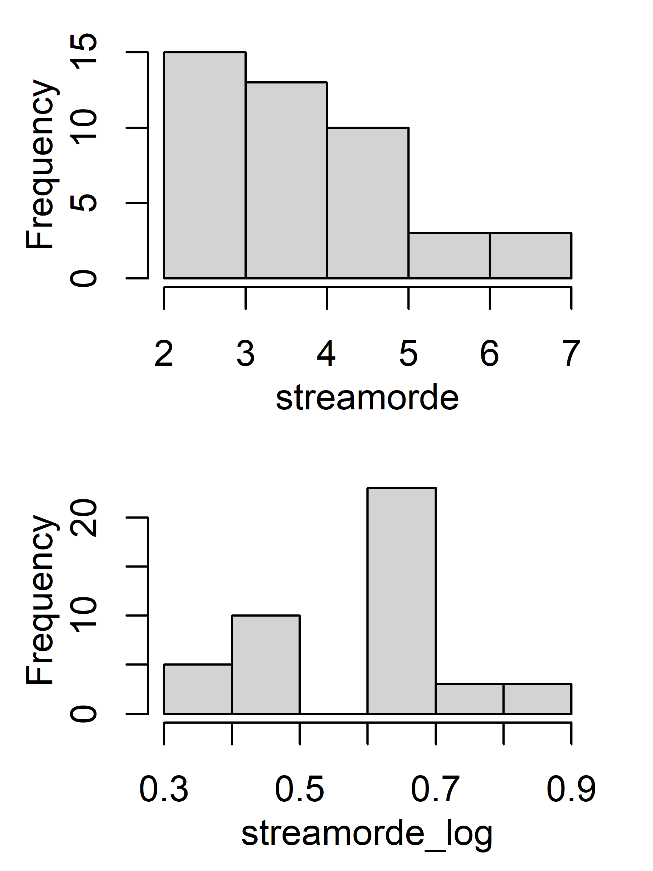
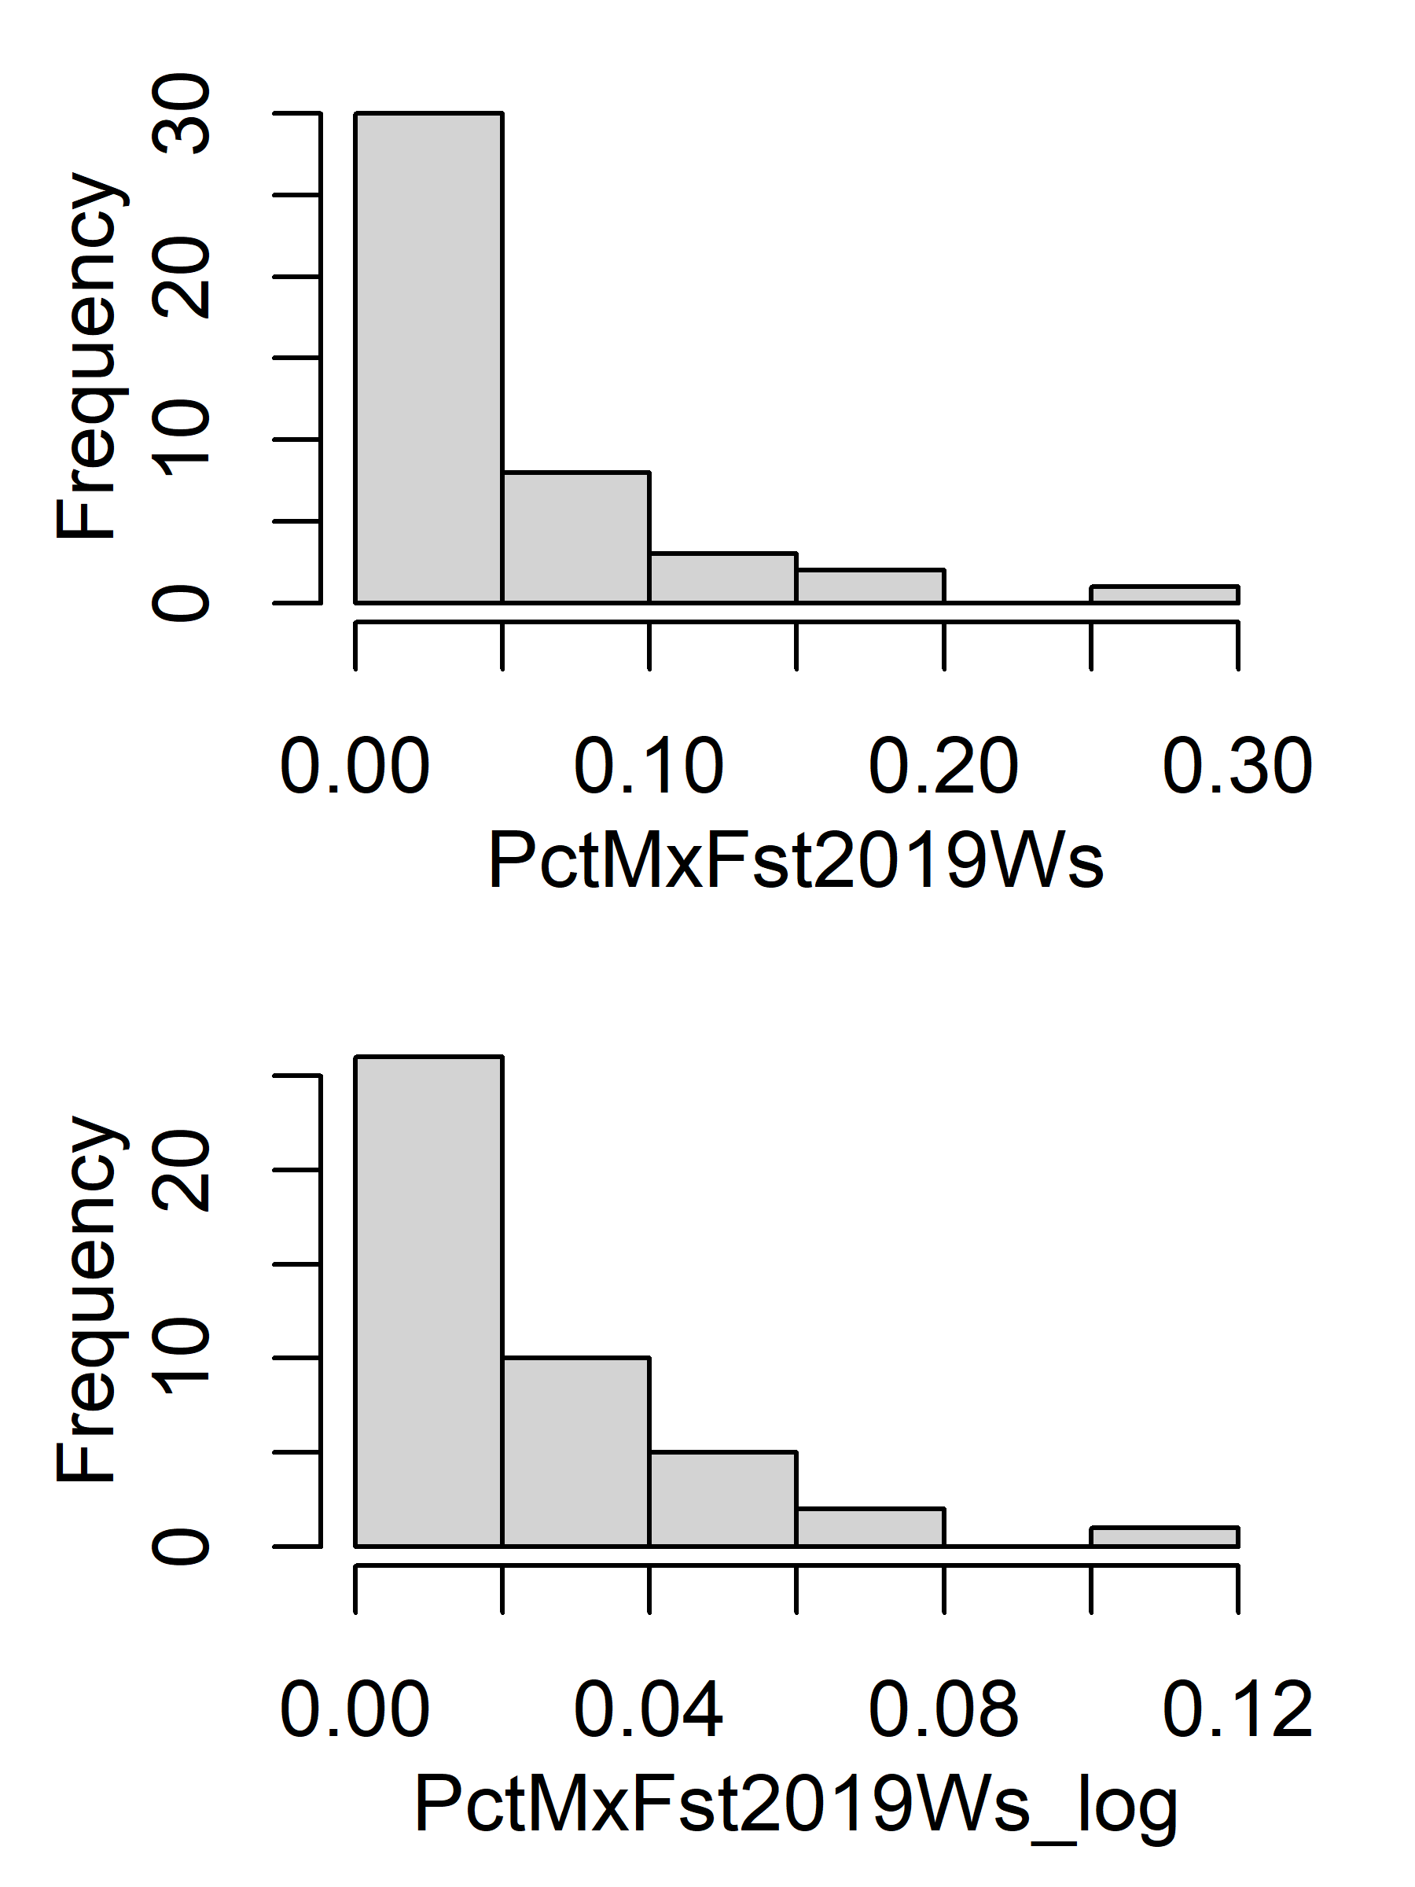
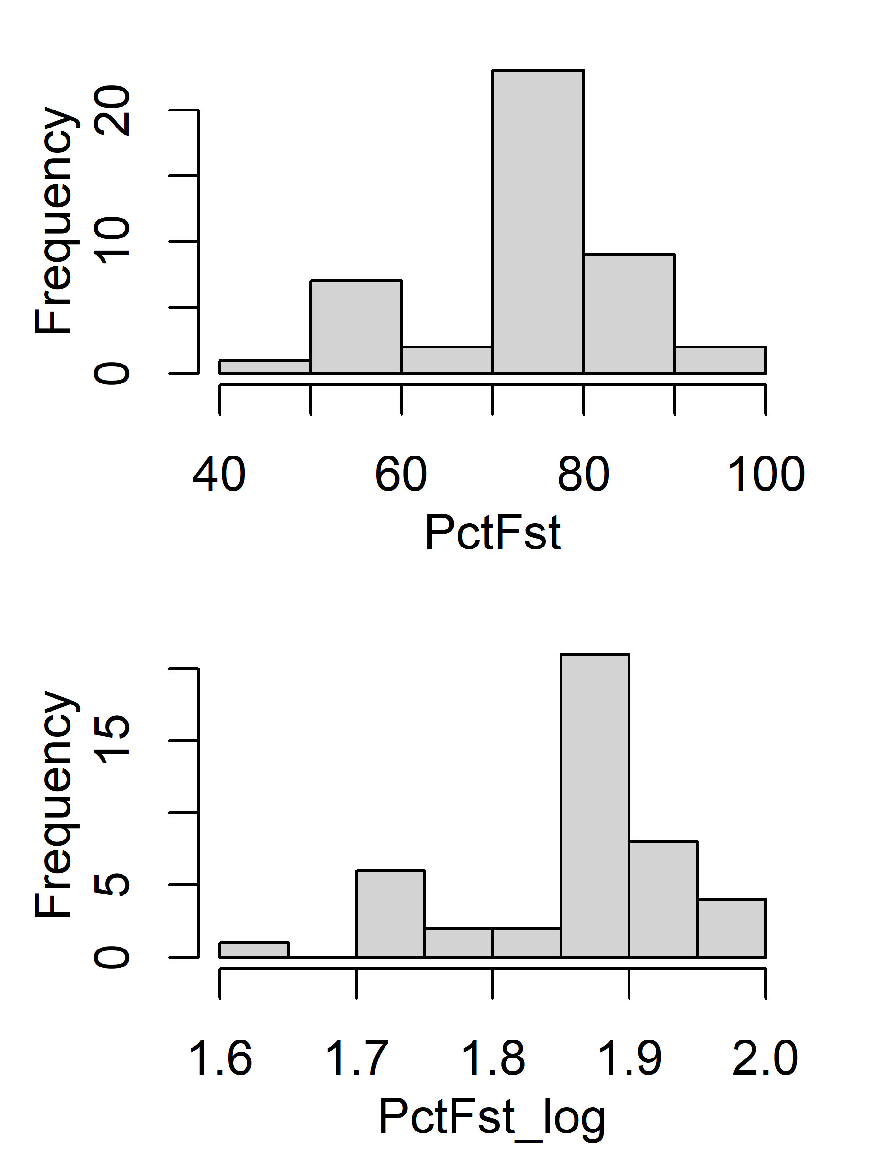
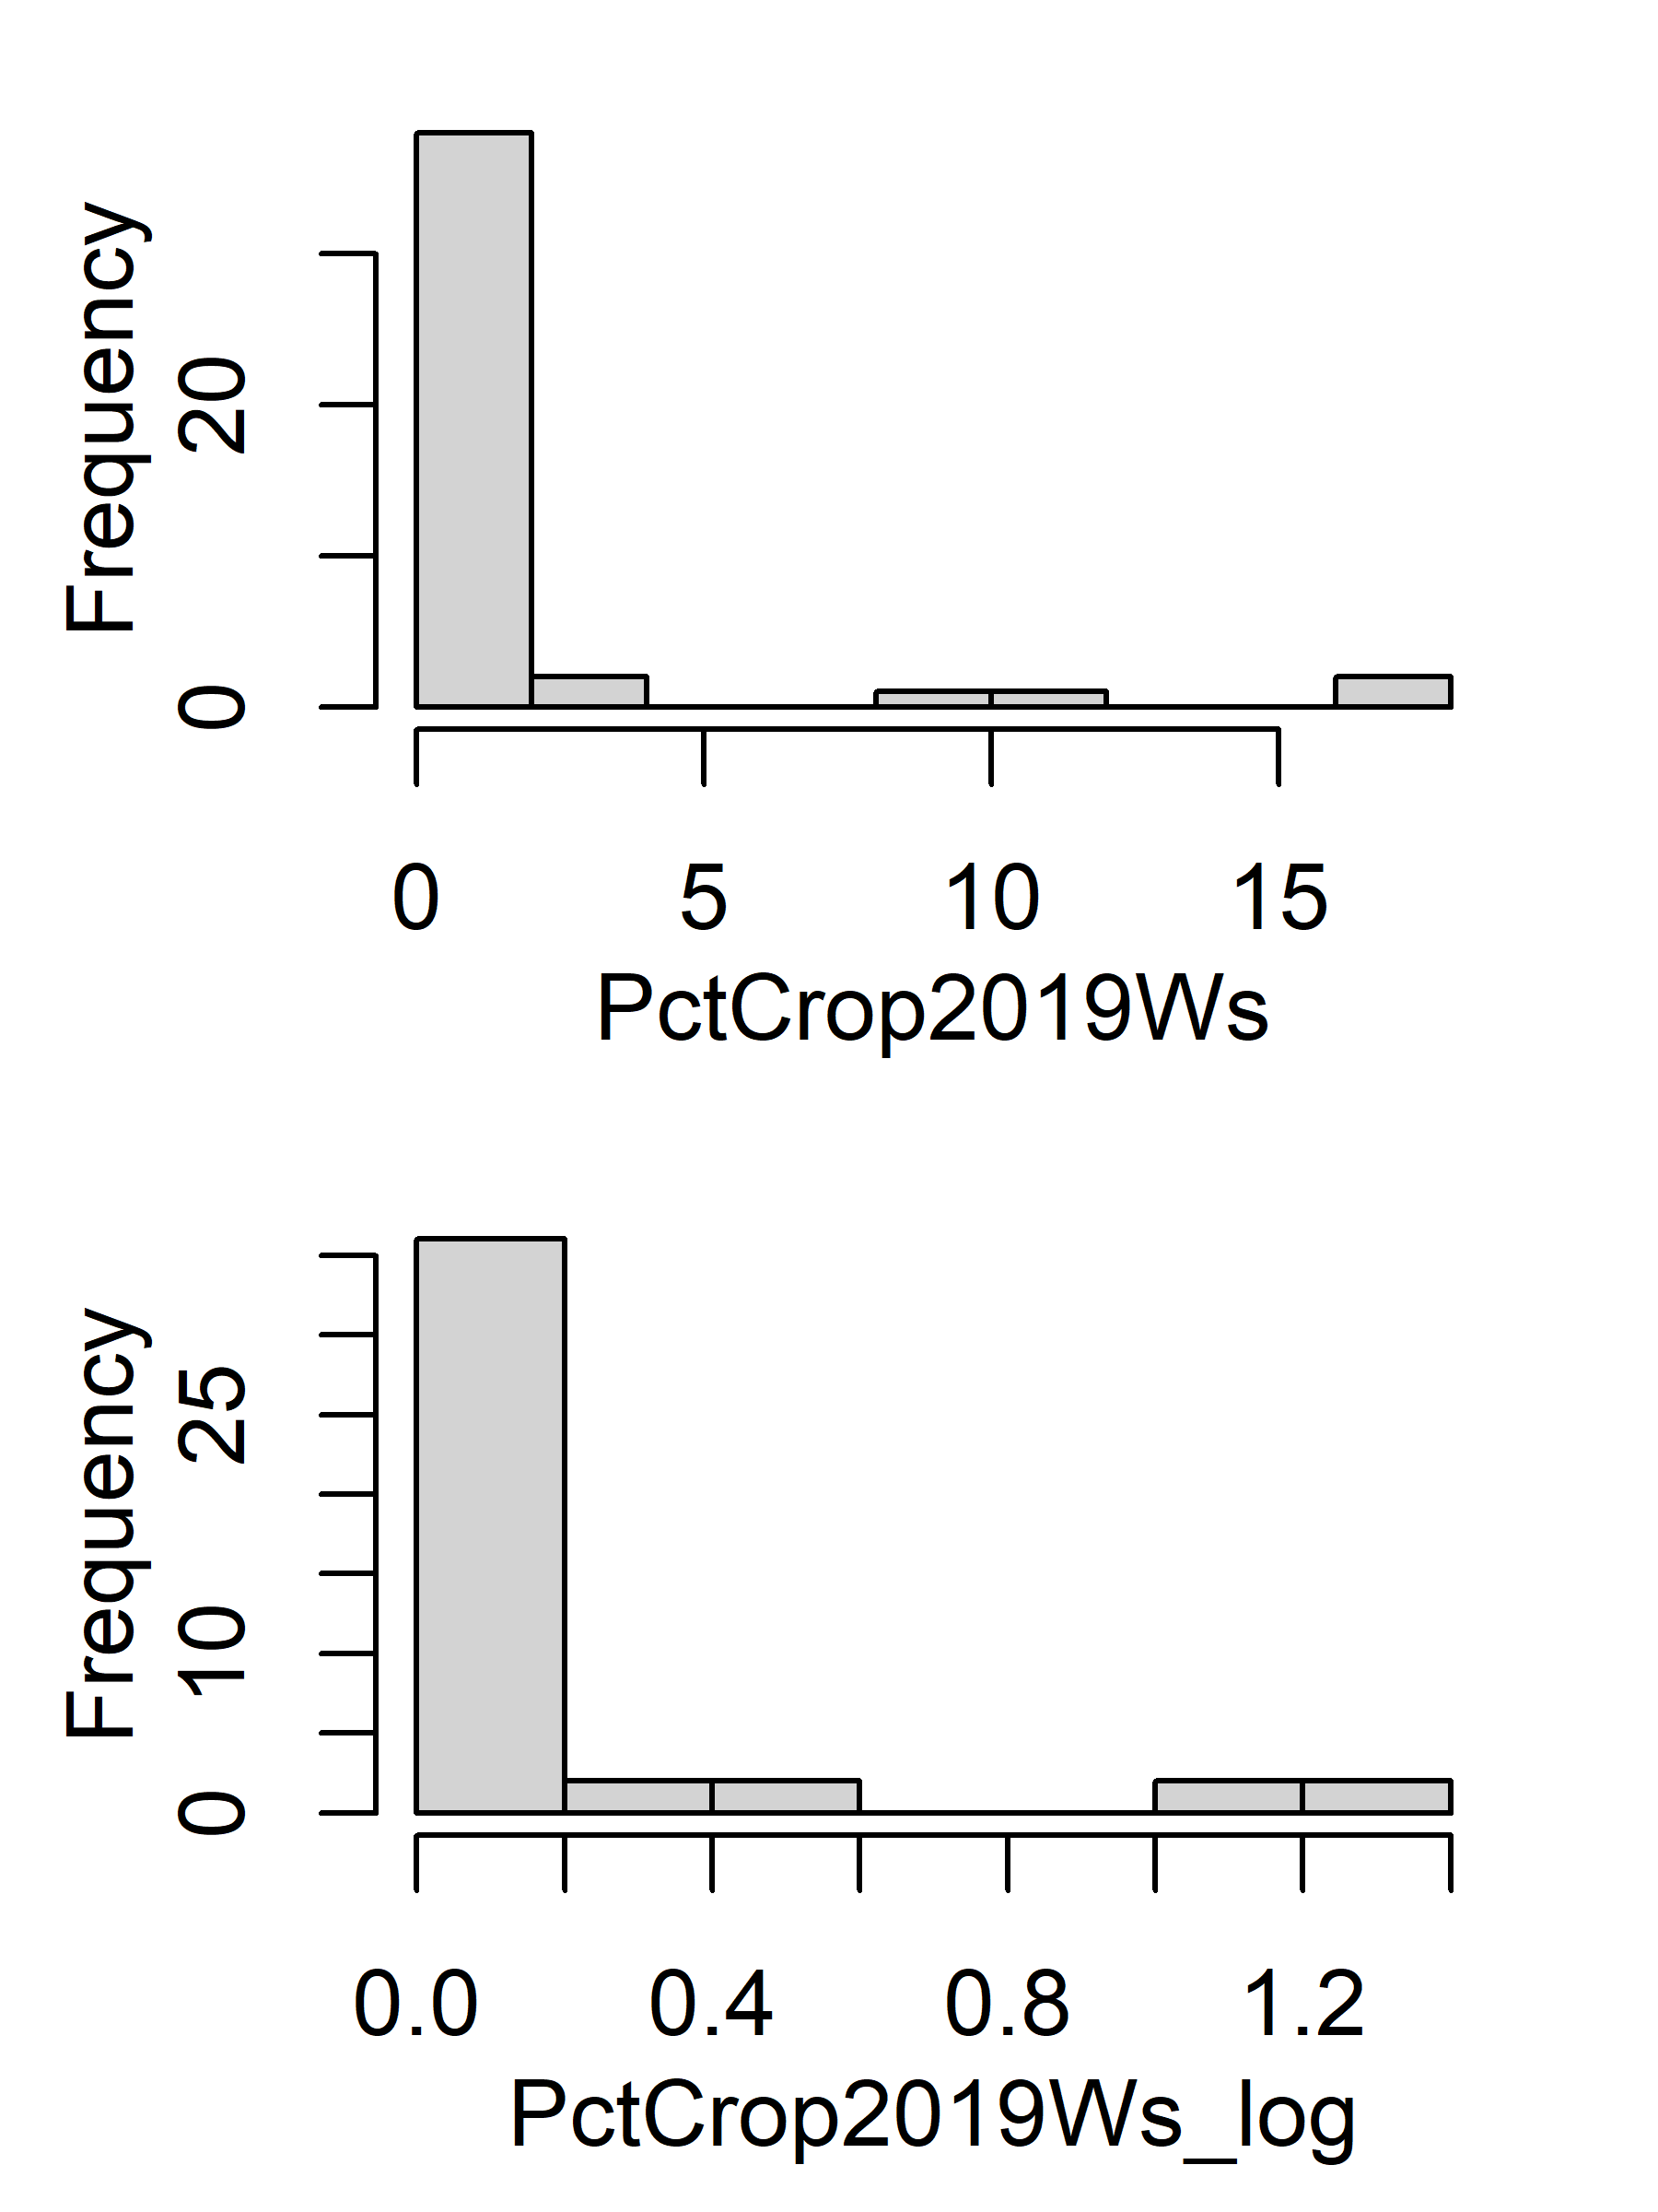
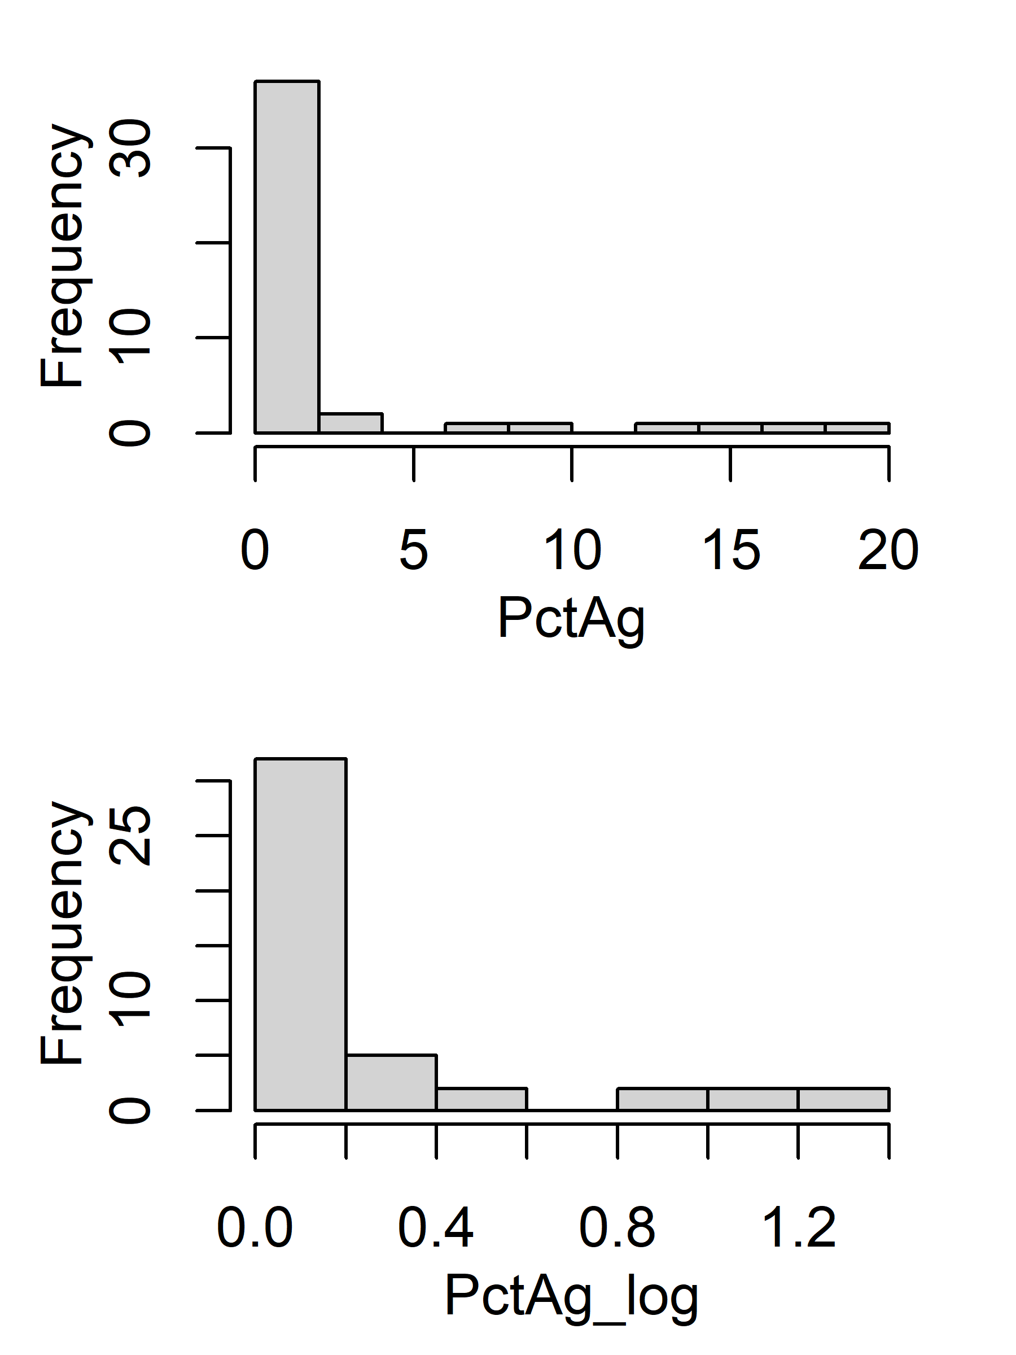
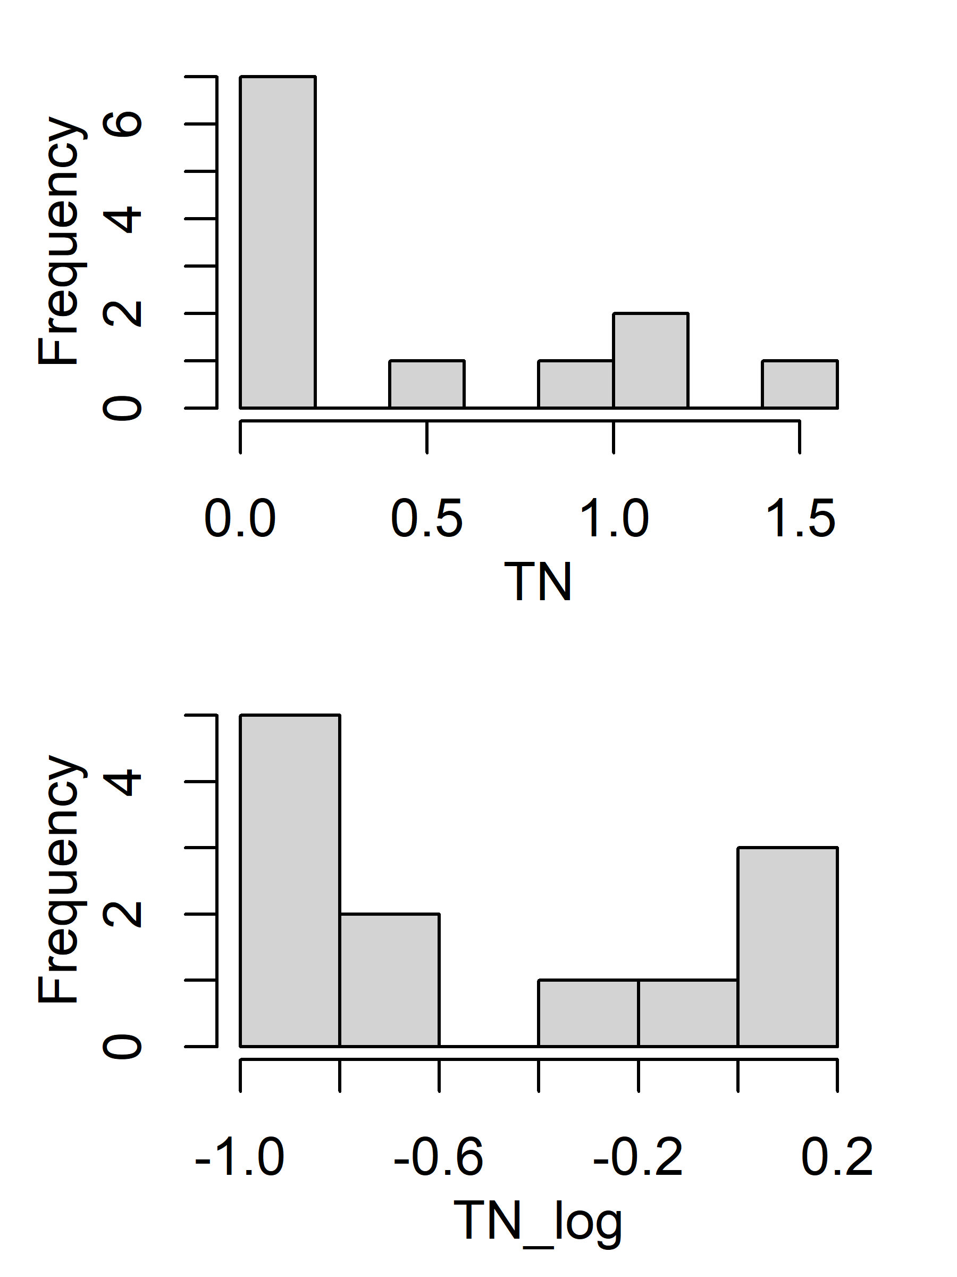
Histogram (original vs log)
#%Forest(PctFst) = %Coniferous+%Evergreen + %Mix
%Ag(PctAg) = %Crop + %Pasture/Hay;

Slide 4
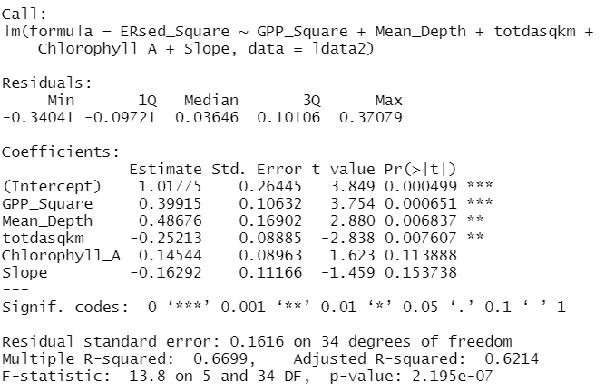
MLR forward/backward selection
Log transform variables(inputs and target variable)
Exclude PctAg(%Crop + %Pasture/Hay) and TN due to skewed distribution after log transformation
Only 40 sites left after removing positive ERsed and NA in variables
Best model for both forward/backward selection: log(ERsed)~ log(GPP_Square) + log(Mean_Depth) + log(totdasqkm) + log(Chlorophyll_A) + log(Slope)

Slide 5
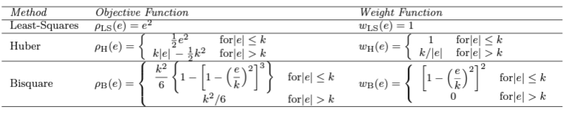
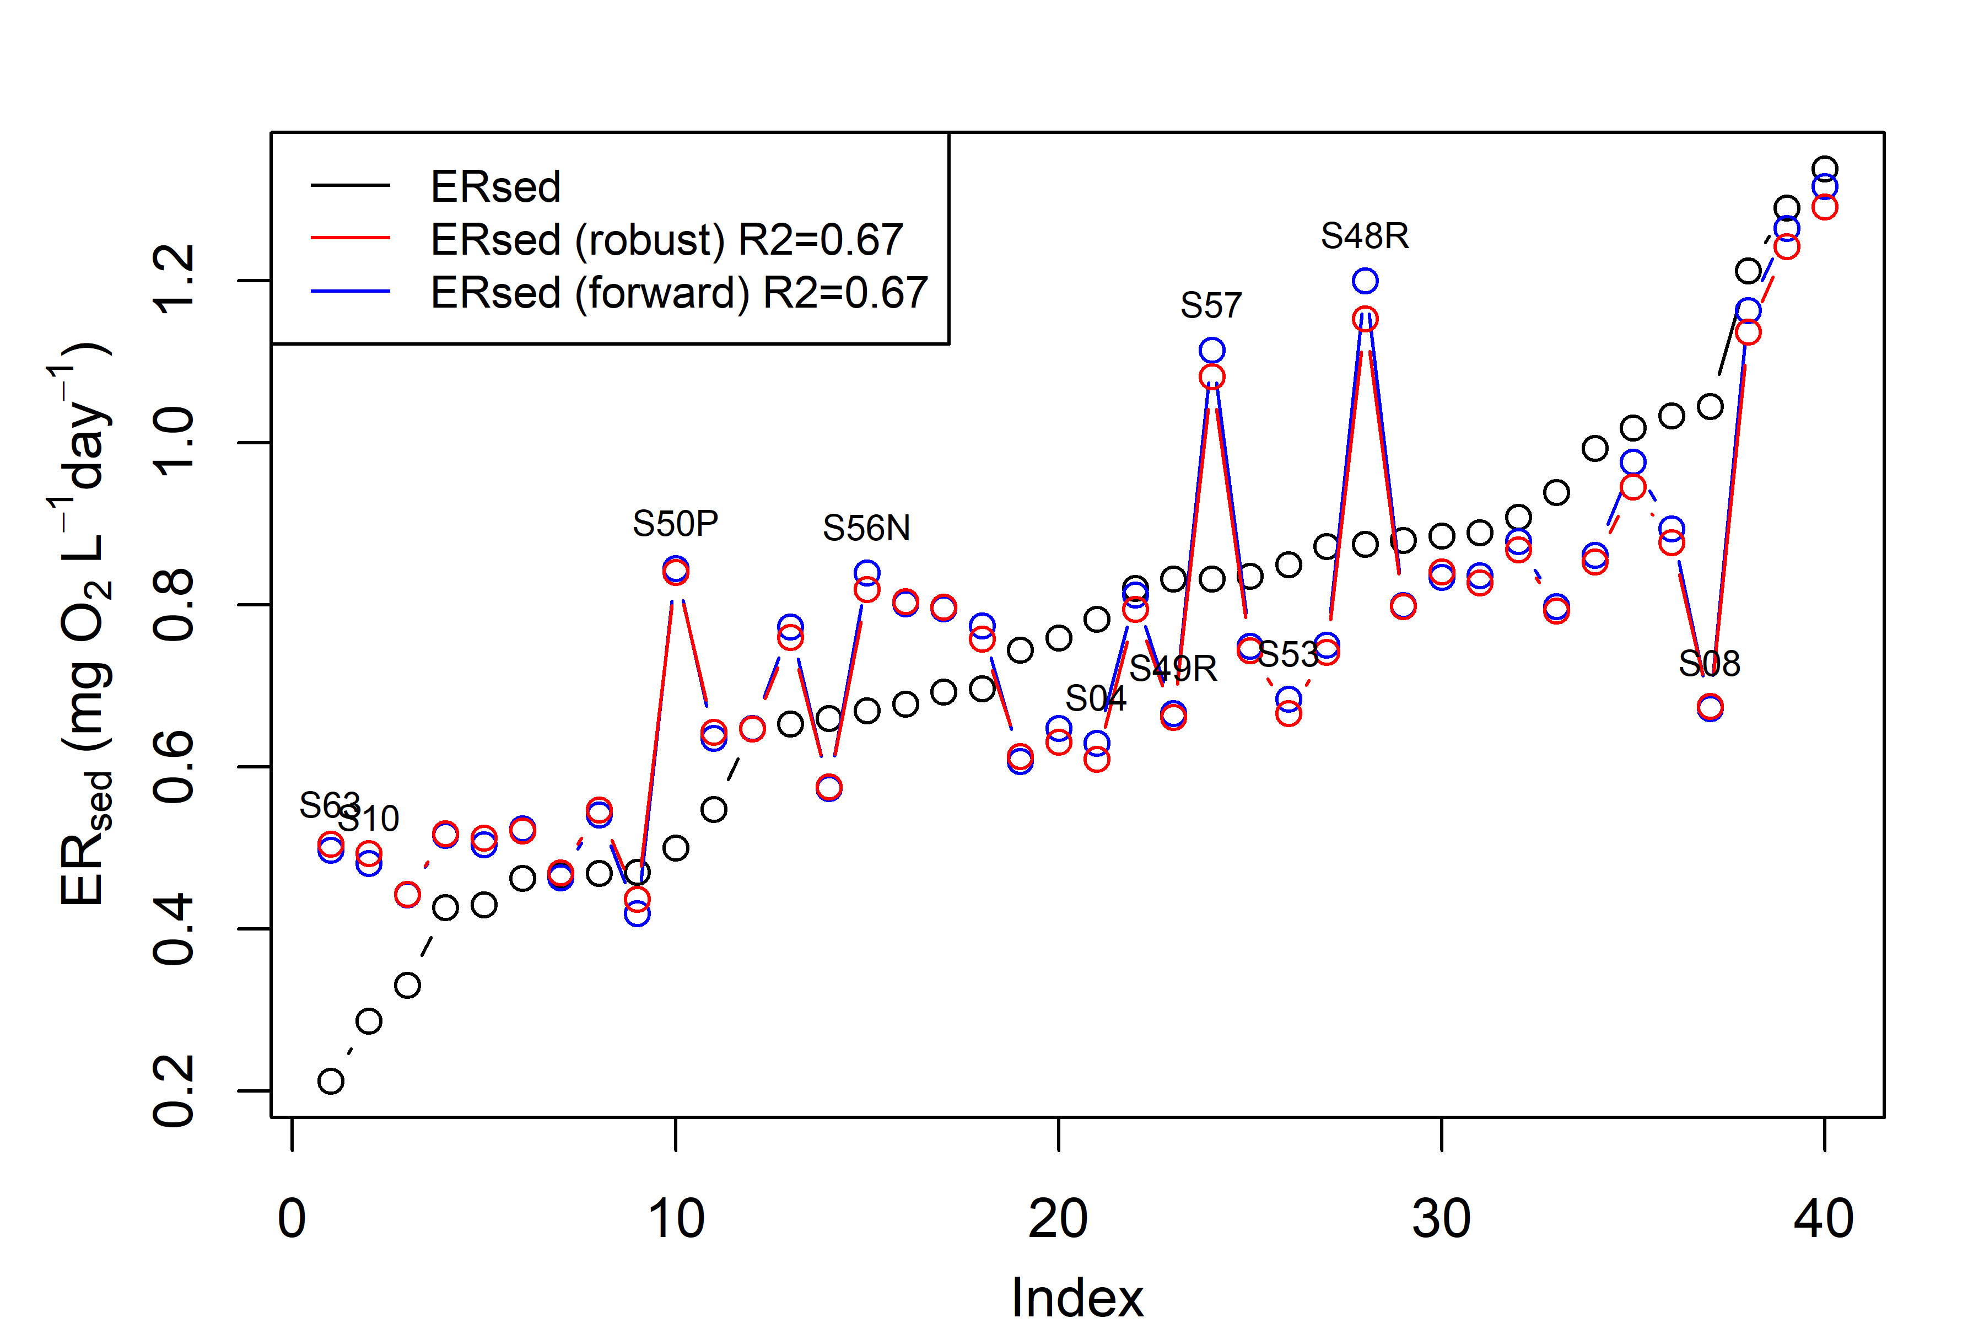
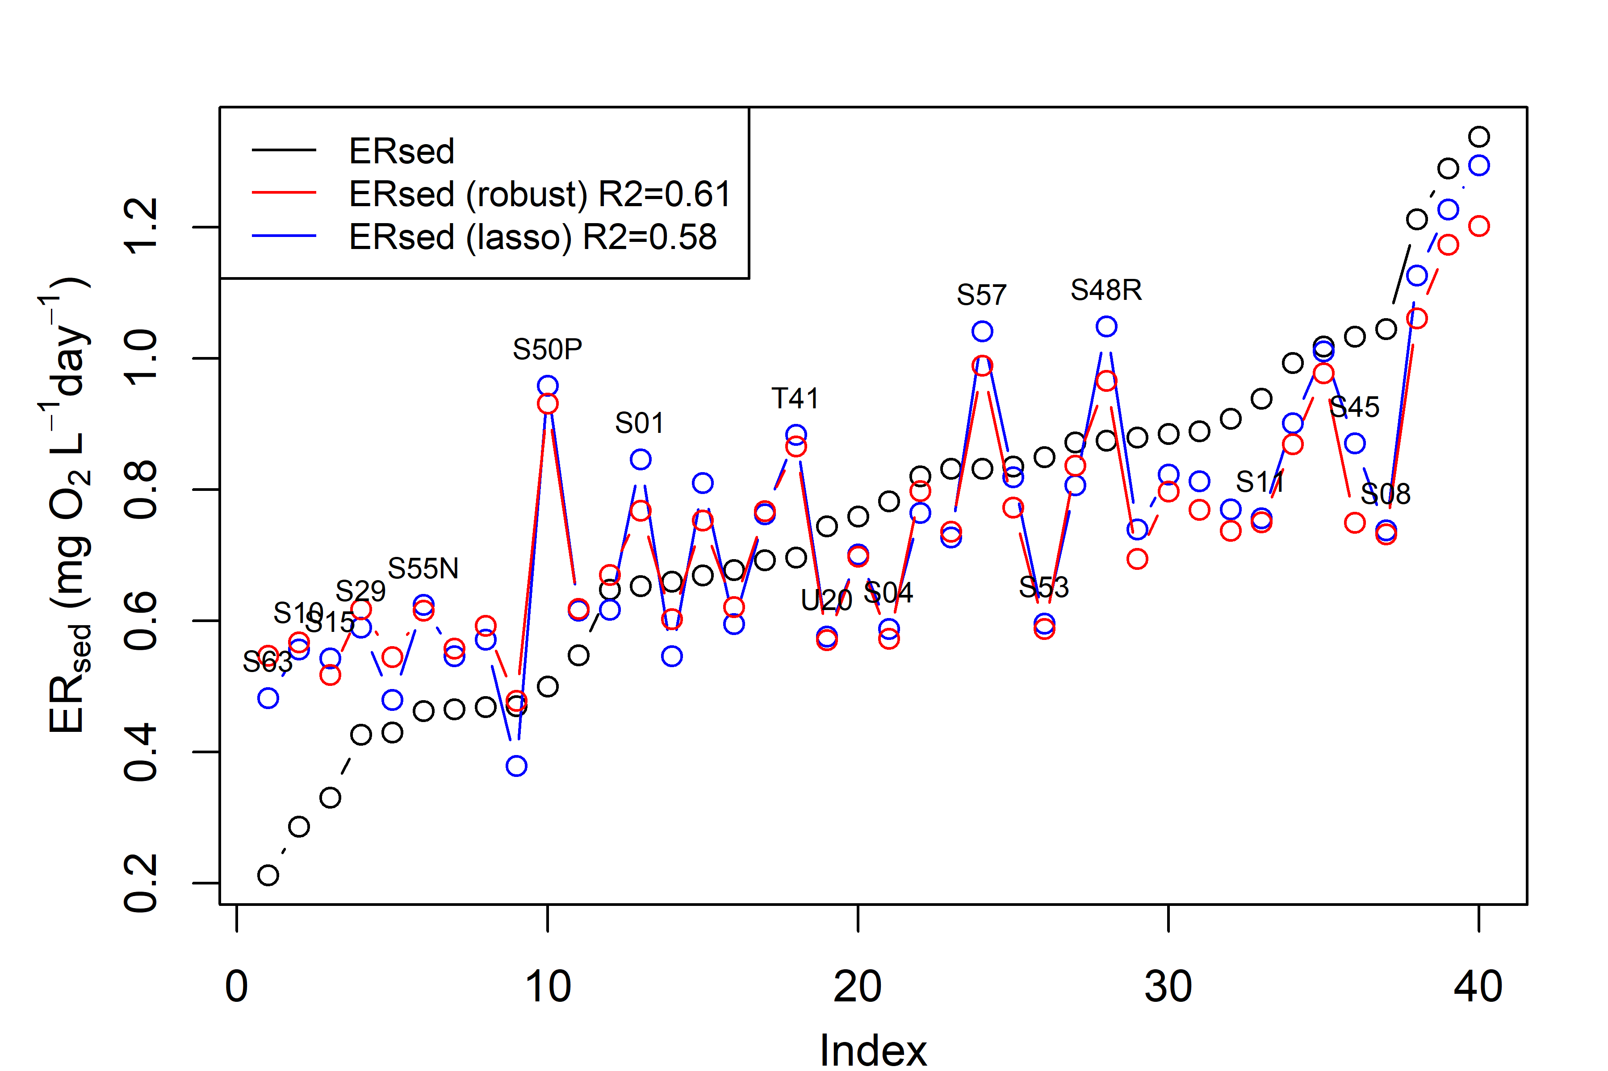
Robust regression (M-estimation)
Log transform variables(inputs and target variable)
Exclude PctAg(%Crop + %Pasture/Hay) and TN due to skewed distribution after log transformation
Only 40 sites left after removing positive ERsed and NA in variables
M-estimation: a general method of robust regression, can be regarded as a generalization of maximum-likelihood estimation.
Residual:
$$MLR\left(forward\right):{ER}_{sed}\sim 0.4∗GPP_{Square}−0.16∗Slope−0.25∗totdasqkm+0.49∗Mean_{Depth}+0.15∗Chlorophyll_A$$
$$lasso:{ER}_{sed}\sim 0.31∗GPP_{Square}−0.14∗Slope−0.02∗hz_{spring}+0.06∗Chlorophyll_{A}$$
$$+0.002∗PctFst+0.04∗AridityWs$$
$$robust: {ER}_{sed}\sim 0.44∗GPP_{Square}−0.14∗Slope−0.25∗totdasqkm+0.49∗Mean_{Depth}+0.16∗Chlorophyll_A$$
robust$:{ER}_{sed}\sim 0.36∗GPP_{Square}−0.15∗Slope−0.04∗hz_{spring}+0.13∗Chlorophyll_{A}$
$+0.001∗PctFst+0.11∗AridityWs$

Slide 6
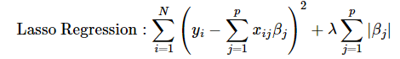
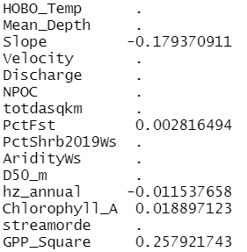
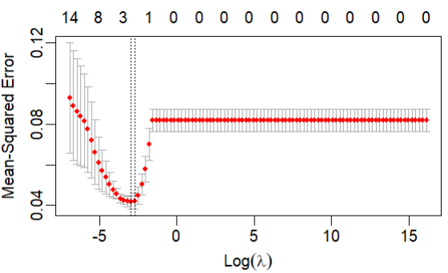
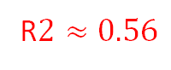
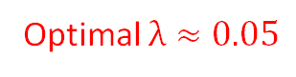
Lasso regression
Log transform variables(inputs and target variable)
Exclude PctAg(%Crop + %Pasture/Hay) and TN due to skewed distribution after log transformation
Fill in (ERtot –mean(ERwc)) for Site T03 (originally NA)
Only 41 sites left after removing positive ERsed and NA in variables
Optimal $λ≈0.05$
R$2≈0.56$

Slide 7
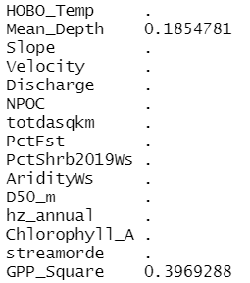
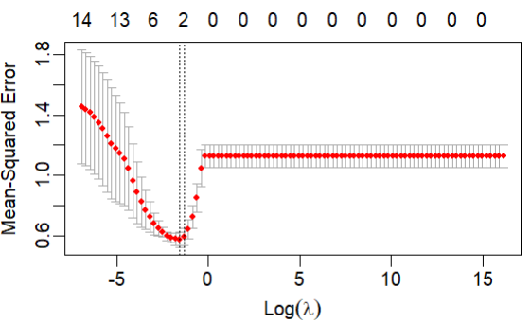
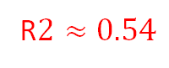
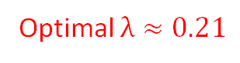
Lasso regression
Log transform variables (inputs and target variable) + normalized variables
Exclude PctAg(%Crop + %Pasture/Hay) and TN due to skewed distribution after log transformation
Fill in (ERtot –mean(ERwc)) for Site T03 (originally NA)
Only 41 sites left after removing positive ERsed and NA in variables
Optimal $λ≈0.21$
R$2≈0.54$

Slide 8
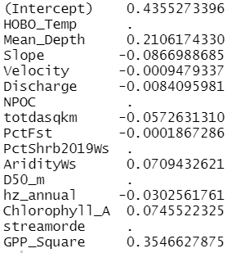
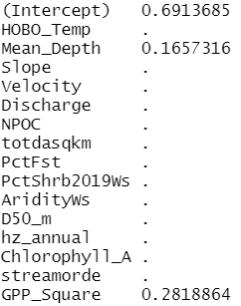
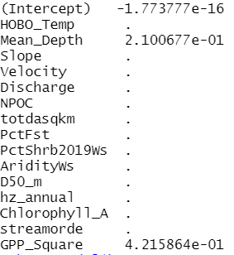
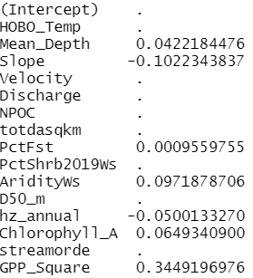
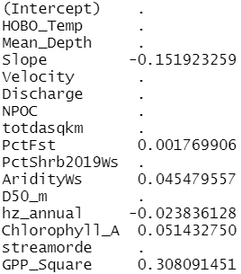
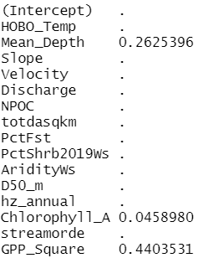
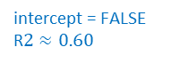
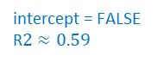
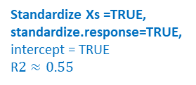

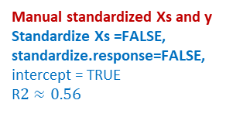
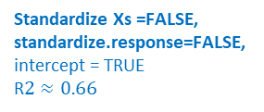
Lasso regression
Standardize Xs =FALSE,
standardize.response=FALSE,
intercept = TRUE
R$2≈0.66$
Standardize Xs =TRUE,
standardize.response=TRUE,
intercept = TRUE
R$2≈0.55$
Manual standardized Xs and y
Standardize Xs =FALSE,
standardize.response=FALSE,
intercept = TRUE
R$2≈0.56$
intercept = FALSE
R$2≈0.63$
intercept = FALSE
R$2≈0.60$
intercept = FALSE
R$2≈0.59$

Slide 9
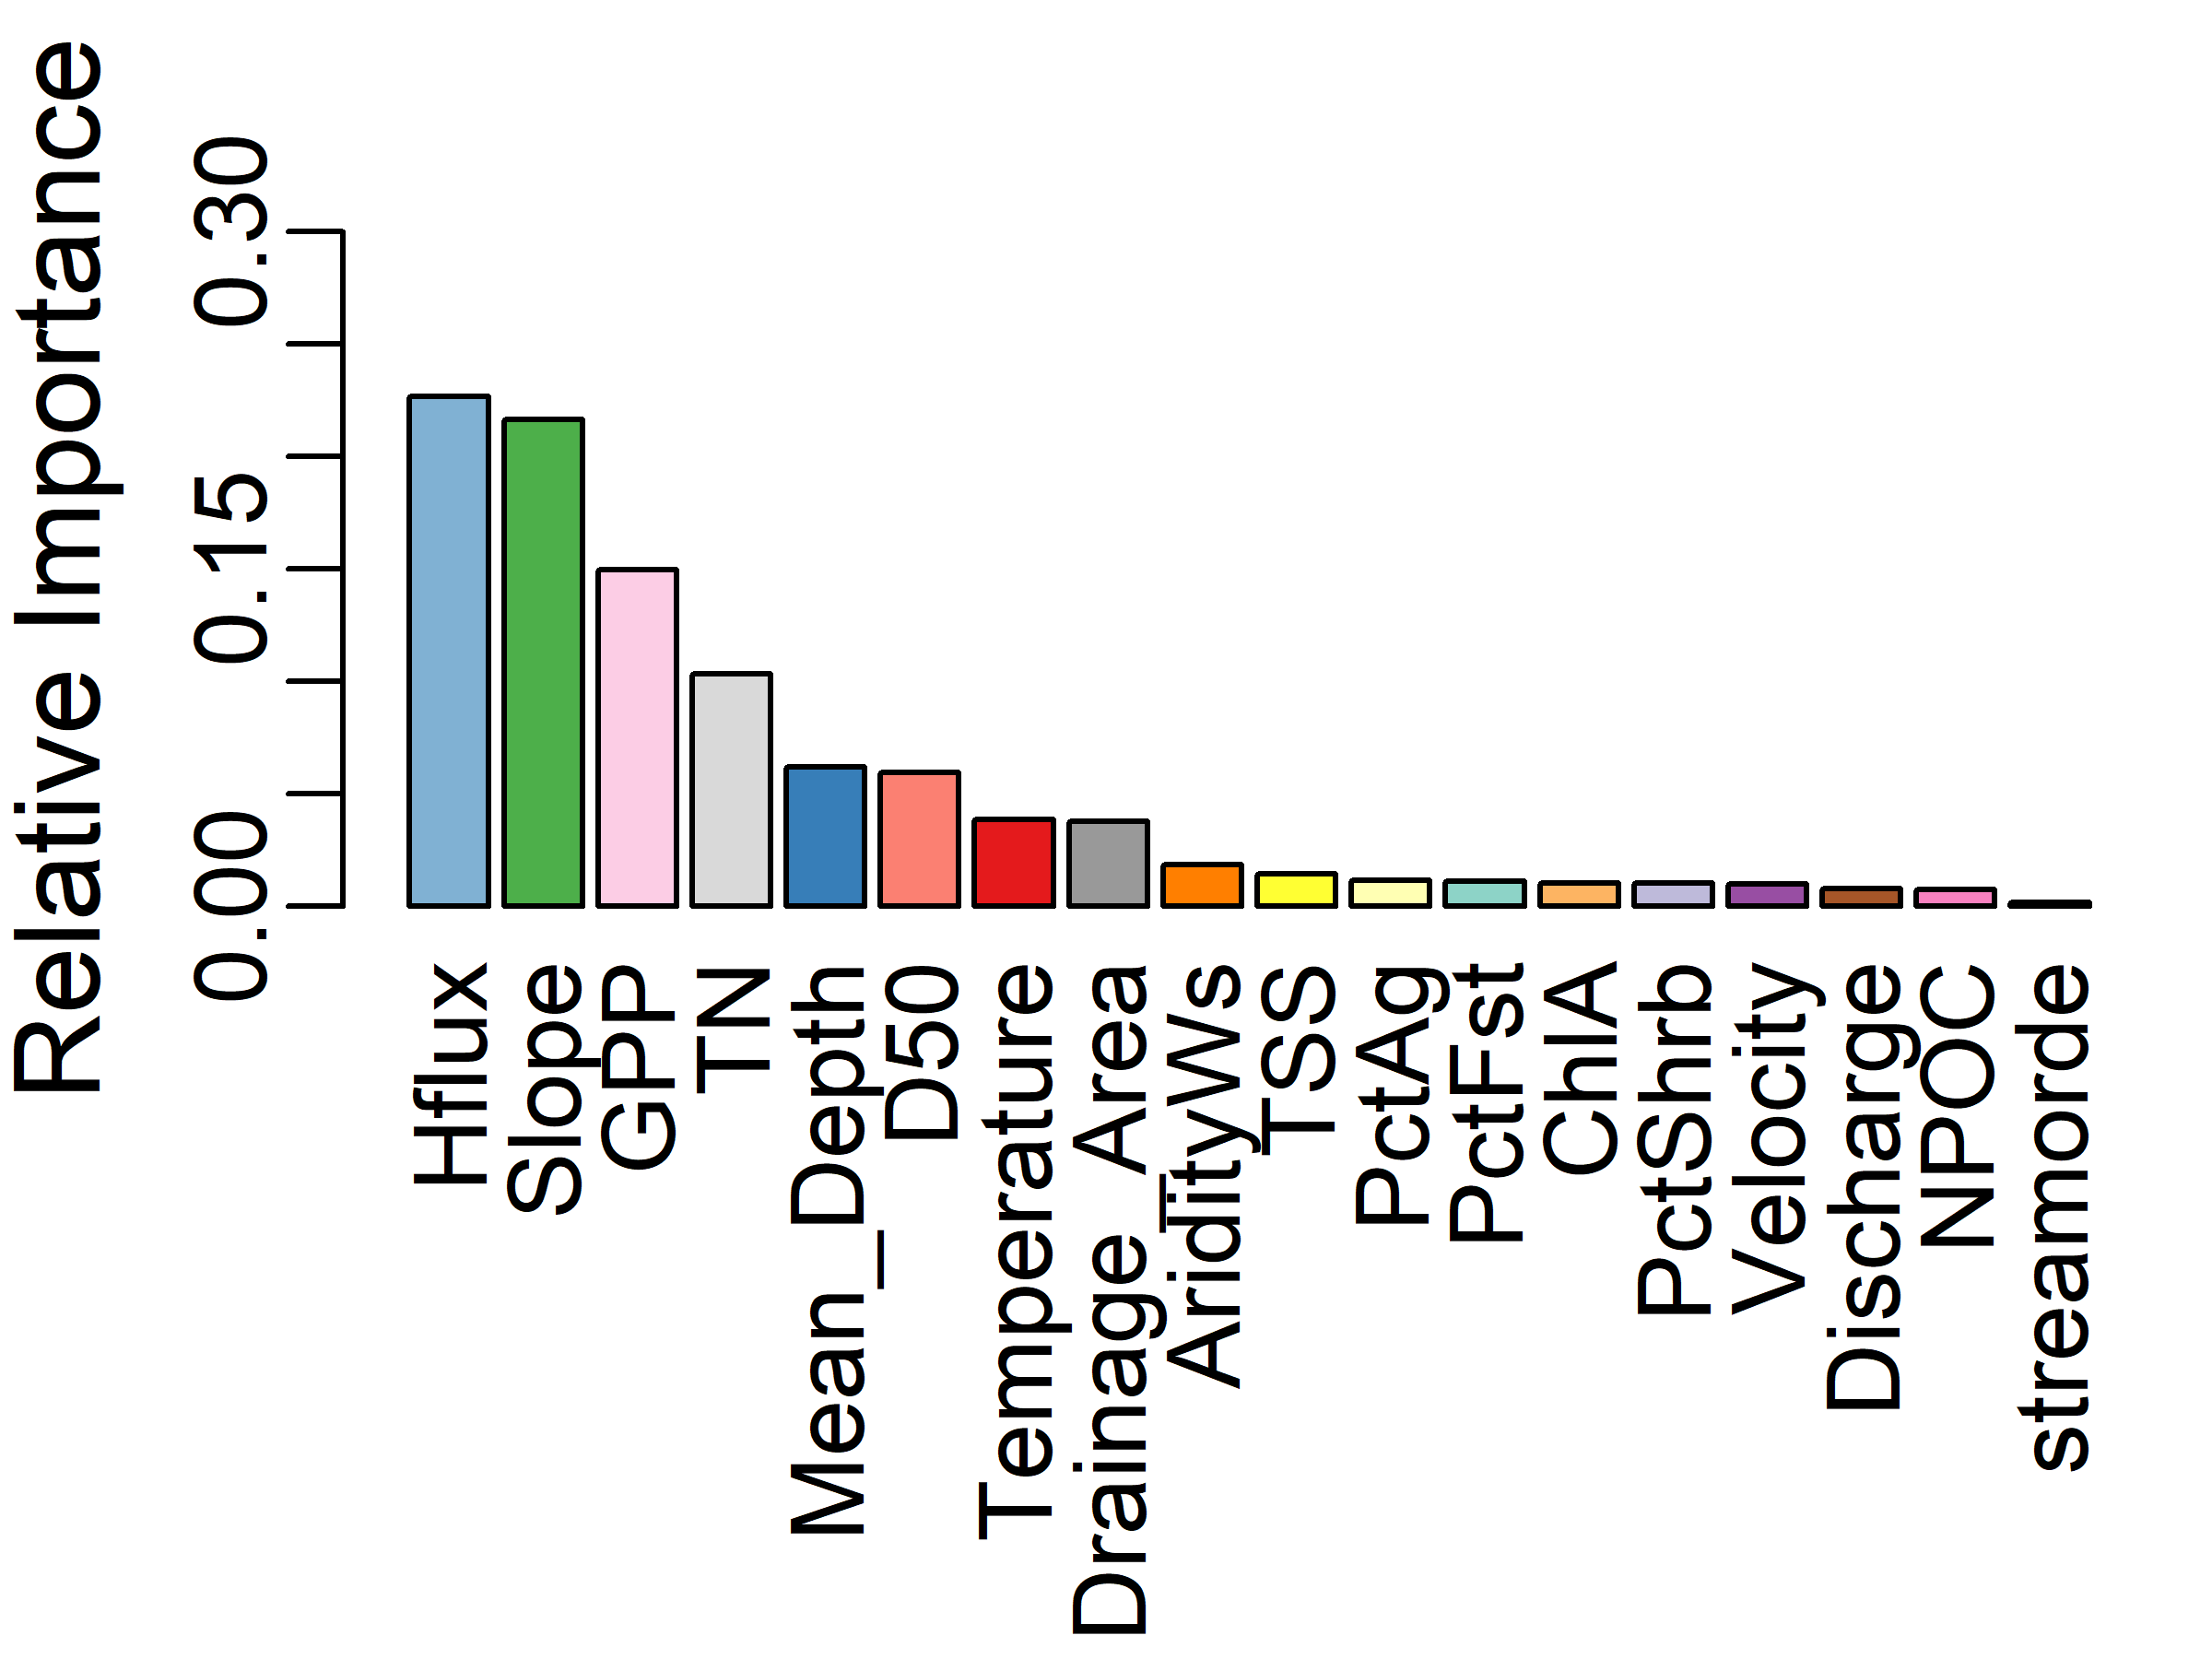
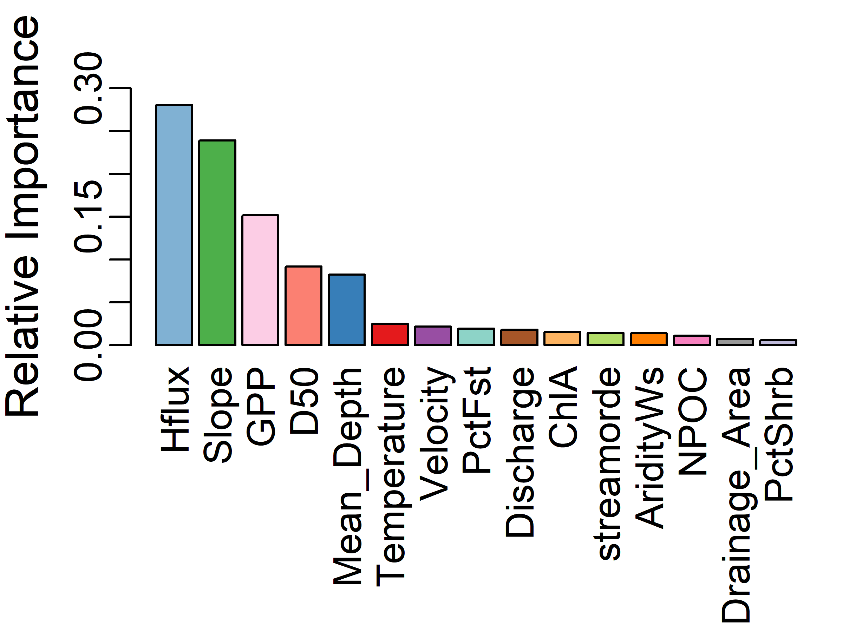
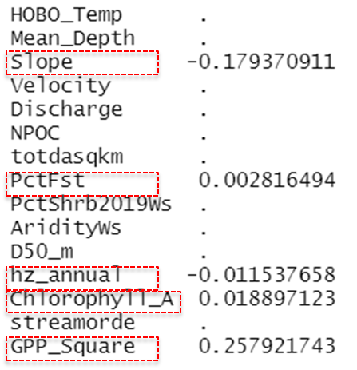
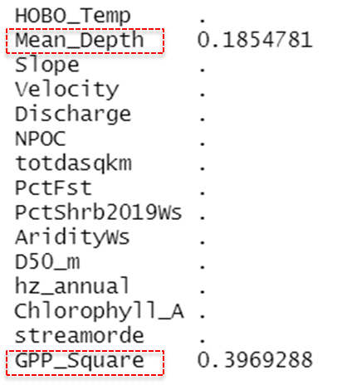
Random forest and Lasso
Fill in (ERtot –mean(ERwc)) for Site T03 (originally NA)
Only 41 sites left after removing positive ERsed and NA in variables
All variables
TN filled with half of the minimum observed value
39 sites left after removing positive ERsed and NA in variables
R2 ~56%
Exclude PctAg and TN to keep the same input variables as LASSO regression
41 sites left after removing positive ERsed and NA in variables
R2~59%
Lasso
Lasso
Log transform variables(inputs and target variable)
Exclude PctAg and TN due to skewed distribution after log transformation
41 sites left after removing positive ERsed and NA in variables
R2~48%
Log transform variables(inputs and target variable) + normalized variables
Exclude PctAg and TN due to skewed distribution after log transformation
41 sites left after removing positive ERsed and NA in variables
R2~48%

Slide 10
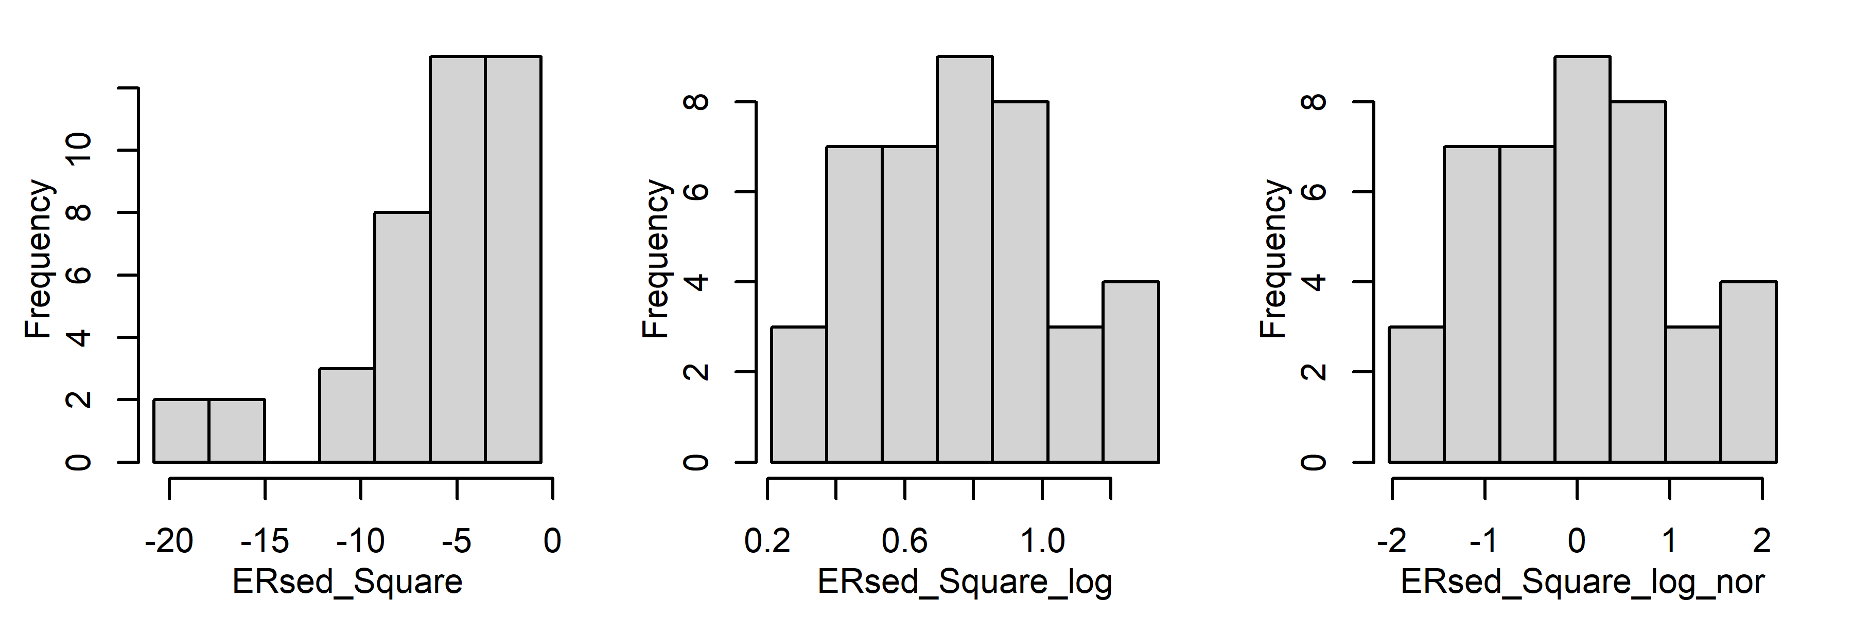
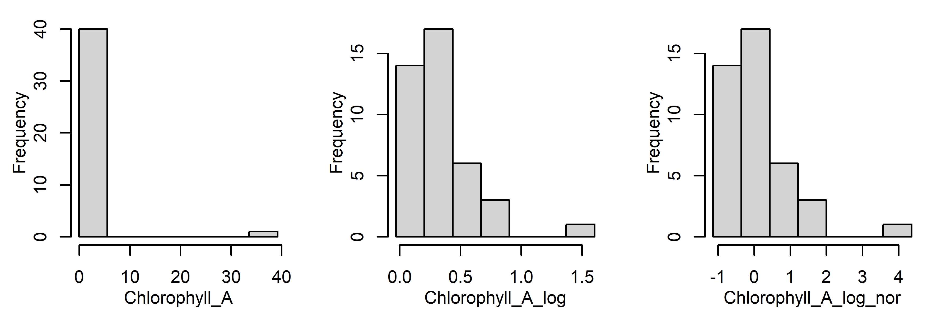






Histogram (original vs log vs normalized)

Slide 11







Histogram (original vs log vs normalized)
Note: the original values for 'hz_annual’ have been log-transformed
Log transform didn’t make these three variables, i.e., "AridityWs","HOBO_Temp","PctFst” more normal, so their original values are used before doing the normalization.

Slide 12




Lasso regression
Log transform variables(inputs and target variable) + normalized variables
Exclude PctAg(%Crop + %Pasture/Hay) due to skewed distribution after log transformation
Exclude Mean_Depth
Fill in (ERtot –mean(ERwc)) for Site T03 (originally NA)
Fill in TN with half of minimum value
Only 41 sites left after removing positive ERsed and NA in variables
R$2≈0.62$
Optimal $λ≈0.06$

Slide 13


Random forest and Lasso
Fill in (ERtot –mean(ERwc)) for Site T03 (originally NA) ;
Fill in TN with half of minimum value
Exclude PctAg, and Mean_Depth
Only 41 sites left after removing positive ERsed and NA in variables
Lasso
Log transform variables(inputs and target variable) + normalized variables
Exclude PctAg, and Mean_Depth
Fill in TN with half of minimum value
41 sites left after removing positive ERsed and NA in variables
R2~62%
R2~61%
Lasso
Log transform variables(inputs and target variable)
Exclude PctAg, and Mean_Depth
Fill in TN with half of minimum value
41 sites left after removing positive ERsed and NA in variables
R2~62%

